Slide 1
StaticHS:
A Variant of Reiter’s Hitting Set Tree for Efﬁcient Sequential Diagnosis
SoCS’18
Patrick Rodler, Manuel Herold

Slide 2
Outline
Motivation + Problem
Contributions:
  new definition of Sequential Diagnosis Problem
  new algorithm to solve this problem
Evaluation + Results
Conclusions + Future Work

Slide 3
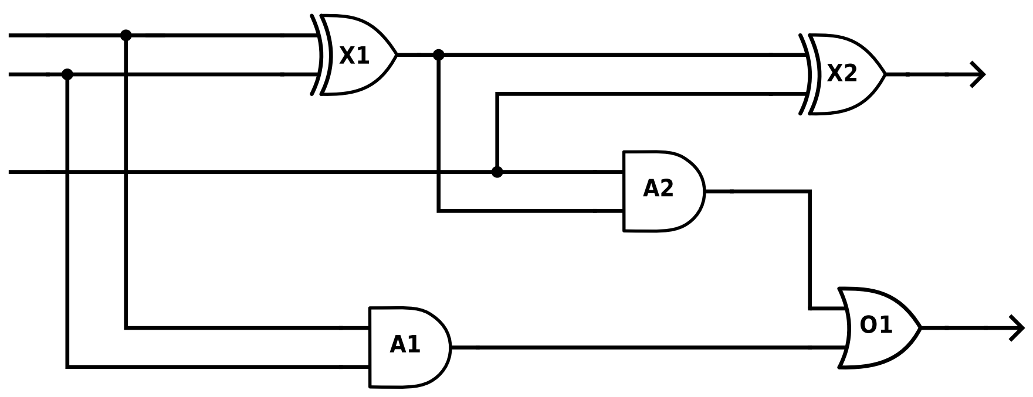

Motivation
An important sub-task of debugging is the efficient localization of the fault
Fault Localization:
Given: system (e.g., SW, HW, KB, physical device, CSP, ontology, etc.)
consisting of a set of components (e.g., lines of code, gates, logical sentences)
which does not behave as expected
Find: the faulty components that cause the misbehavior
Example: Full-Adder does not add properly
Discrepancy (Prediction vs. Observation)
Components
Observations
1
1
1
0
$$≠$$
0
1
0
sum bit
1
1
Predictions
Find faulty
components!
0
carry bit

Slide 4


Diagnosis Problem Instance
Formally: A diagnosis problem instance (DPI) $〈SD,COMPS,MEAS〉$ consists of
system description $SD$
(includes $ok\left(X_{1}\right)→out\left(X_{1}\right)=xor(in_{1}\left(X_{1}\right),in_{2}(X_{1}))$ etc., $out\left(X_{1}\right)=in_{1}(X_{2})$ etc.)
components $COMPS$
($=\{X_{1},X_{2},A_{1},A_{2},O_{1}\}$, includes all system components)
observations/measurements $MEAS$
(includes $in_{1}\left(X_{1}\right)=1,…,out\left(O_{1}\right)=0$)
(Initial) DPI $dpi_{0}$
1
0
1
sum bit
1
0
carry bit

Slide 5

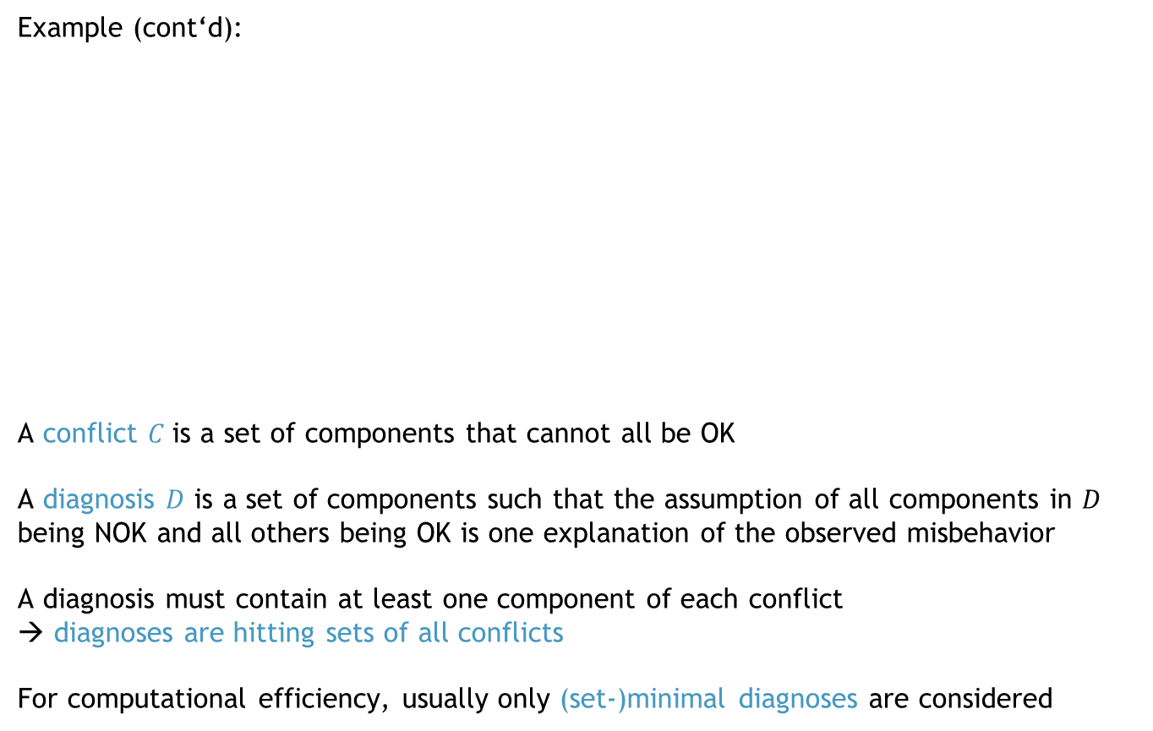





Conflicts + Diagnoses
Initial DPI $dpi_{0}$
Example (cont‘d):
A conflict $C$is a set of components that cannot all be OK
A diagnosis $D$ is a set of components such that the assumption of all components in $D$ being NOK and all others being OK is one explanation of the observed misbehavior
A diagnosis must contain at least one component of each conflict
→ diagnoses are hitting sets of all conflicts
For computational efficiency, usually only (set-)minimal diagnoses are considered
1
$$C_{1}$$
0
$$D_{1}$$
1
1
$$D_{3}$$
$$D_{2}$$
$$C_{2}$$
0
In what follows,
we only talk about
minimal diagnoses!
Notes:
A diagnosis $D$ is a set of components whose NOK-state explains the
observed misbehavior (while all components not in $D$ are assumed OK)

Slide 6













Measurements
$$<SD,COMPS,MEAS∪\{out\left(A_{2}\right)=1\}>$$
$$<SD,COMPS,MEAS∪\{out\left(A_{2}\right)=0\}>$$
$$<SD,COMPS,MEAS>$$
$$<SD,COMPS,MEAS>$$
New DPI $dpi_{1}$
Initial DPI $dpi_{0}$
(Other) New DPI $dpi_{1}$
Initial DPI $dpi_{0}$
Example (cont‘d):
Which diagnosis among $D=\{D_{1},D_{2},D_{3}\}$ pinpoints the actually faulty components?
Collect further information about system to rule out diagnoses → make measurements
E.g.: Measurement point $out\left(A_{2}\right)$ is discriminating wrt. $D$
if outcome is 0, then $D_{3}$ is no longer a diagnosis (since $X_{1}$ or $A_{2}$ must be NOK)
if outcome is 1, then $D_{1},D_{2}$ are no longer diagnoses (since $O_{1}$ must be NOK)
1
$$C_{1}$$
0
$$D_{1}$$
1
1
$$D_{3}$$
0
$$D_{3}$$
?
1
?
new diagnosis
$$C_{2}$$
$$D_{2}$$
$$C_{2}$$
$$D_{4}$$
$$C_{2}$$
$$C_{2}$$
0
Notes:
with $\left\langle p\left(D_{1}\right),p\left(D_{2}\right),p\left(D_{3}\right)\right\rangle =\left\langle 0.93, 0.05, 0.02\right\rangle$
$$\left\{out\left(A_{2}\right)\right\}$$

Slide 7




Measurements
For any set of $≥2$ diagnoses, a discriminating
measurement exists.
Initial DPI $dpi_{0}$
New DPI $dpi_{1}$
Example (cont‘d):
Which diagnosis among $D=\{D_{1},D_{2},D_{3}\}$ pinpoints the actually faulty components?
Collect further information about system to rule out diagnoses → make measurements
E.g.: Measurement point $out\left(A_{1}\right)$ is not discriminating wrt. $D$
if outcome is 0, then all diagnoses $D_{1},D_{2},D_{3}$ remain
(since it gives no information about the relevant components $X_{1}$, $X_{2}$, $O_{1}$ or $A_{2}$)
1
$$C_{1}$$
0
$$D_{1}$$
1
1
$$D_{3}$$
$$D_{2}$$
$$C_{2}$$
$$C_{2}$$
0
0
?

Slide 8









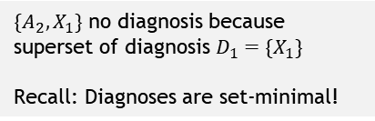









Computation of Diagnoses (Reiter‘s HS-Tree)
Is the assumption that all components are OK consistent with our system knowledge?
No!
So, there must be a conflict!
So, compute one!
Example (cont‘d):
Key:
Conflicts
Paths that are Diagnoses
Paths that are no Diagnoses
$C…$ computed
$R…$ reused
1
$${〈X_{1},A_{2},O_{1}〉}^{C}$$
$$X_{1}$$
$$O_{1}$$
$$A_{2}$$
2
Breadth-first!
(or: uniform-cost,
if weights given)
3
4
✔$(D_{1})$
$${〈X_{1},X_{2}〉}^{C}$$
$${〈X_{1},X_{2}〉}^{R}$$
$$X_{1}$$
$$X_{2}$$
$$X_{1}$$
$$X_{2}$$
Since assuming $nok(X_{1})$ explains all
observed system problems
5
6
7
8
✖$(⊃D_{1})$
✔$(D_{2})$
✖ $(⊃D_{1})$
✔$(D_{3})$
Tree complete, all branches closed:
→ Set of all diagnoses is given by the green paths.
$\{A_{2},X_{1}\}$ no diagnosis because superset of diagnosis $D_{1}=\{X_{1}\}$
Recall: Diagnoses are set-minimal!
Since assuming $nok(A_{2})$ does not
explain observed system problems
Reiter, R. 1987. A Theory of Diagnosis from First Principles. Artif. Intell. 32(1):57-95

Slide 9









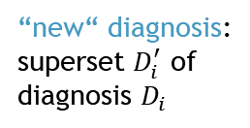




Sequential Diagnosis
different possible algorithms
(e.g. Reiter‘s HS-Tree)
hard computational task, can usually
only compute some diagnoses
Process:
Evolution of the space of diagnoses:
input
output
DPI
compute diagnoses $D$
actually faulty components
$$\left|D\right|=1$$
iteration 0: $dpi_{0}$
iteration 1: $dpi_{1}$
iteration 2: $dpi_{2}$
…
$$D$$
update knowledge
compute measure-ment point $p_{i}$
maybe: optimize based
on some heuristic, e.g.
information gain
expensive!!
$〈SD,COMPS,MEAS〉$ becomes
$〈SD,COMPS,MEAS∪\left\{m_{i}\right\}〉$
$$m_{i}$$
ask oracle
$$p_{i}$$
oracle = engineer (physical system),
domain expert (KB), etc.
measure-
ment $m_{1}$
diagnoses for $dpi_{2}$
diagnosis $D_{i}$
invalidates
diagnoses for $dpi_{0}$
…
“new“ diagnosis:
superset $D_{i}^{′}$ of
diagnosis $D_{i}$
diagnoses for $dpi_{1}$

Slide 10

Sequential Diagnosis
different possible algorithms
(e.g. Reiter‘s HS-Tree)
hard computational task, can usually
only compute some diagnoses
Process:
The solved problem is:
DynSD-Problem:
Given: DPI $〈SD,COMPS,MEAS〉$.
Find: Set of measurements $M$ such that there is only one diagnosis for $〈SD,COMPS,MEAS∪M〉$.
Optimization Version:
OptDynSD-Problem:
Given: DPI $〈SD,COMPS,MEAS〉$.
Find: Minimal-cost set of measurements $M$ to solve DynSD problem.
input
output
DPI
compute diagnoses $D$
actually faulty components
$$\left|D\right|=1$$
iteration 0: $dpi_{0}$
iteration 1: $dpi_{1}$
iteration 2: $dpi_{2}$
…
$$D$$
update knowledge
compute measure-ment point $p_{i}$
maybe: optimize based
on some heuristic, e.g.
information gain
expensive!!
$〈SD,COMPS,MEAS〉$ becomes
$〈SD,COMPS,MEAS∪\left\{m_{i}\right\}〉$
$$m_{i}$$
ask oracle
$$p_{i}$$
oracle = engineer (physical system),
domain expert (KB), etc.

Slide 11
Sequential Diagnosis
different possible algorithms
(e.g. Reiter‘s HS-Tree)
hard computational task, can usually
only compute some diagnoses
Process:
Ways to tackle Optimization Problem (OptDynSD):
(existing) selecting “good“ measurement points
(e.g. with high information gain, high expected diagnoses elimination rate)
(we suggest) changing the way of diagnoses computation
(diagnoses search space restriction)
→ both approaches can be readily and well combined with one another
input
output
DPI
compute diagnoses $D$
actually faulty components
$$\left|D\right|=1$$
iteration 0: $dpi_{0}$
iteration 1: $dpi_{1}$
iteration 2: $dpi_{2}$
…
$$D$$
update knowledge
compute measure-ment point $p_{i}$
maybe: optimize based
on some heuristic, e.g.
information gain
expensive!!
$〈SD,COMPS,MEAS〉$ becomes
$〈SD,COMPS,MEAS∪\left\{m_{i}\right\}〉$
$$m_{i}$$
ask oracle
$$p_{i}$$
oracle = engineer (physical system),
domain expert (KB), etc.

Slide 12




Sequential Diagnosis
different possible algorithms
(e.g. Reiter‘s HS-Tree)
hard computational task, can usually
only compute some diagnoses
Process:
Idea:
do not update DPI in each iteration
instead: use new measurements only as constraints on the diagnoses search space
intuitively: “freeze“ diagnoses search space, no “new“ diagnoses
That is, solve another problem:
(Opt)StatSD-Problem:
Given: DPI $〈SD,COMPS,MEAS〉$.
Find: (Minimal-cost) set of measurements $M$ such that there is only one diagnosis for $〈SD,COMPS,MEAS〉$ + constraints $M$.
fixed!
input
keep state! no redundant
computations
output
still valid??
DPI
compute diagnoses $D$
actually faulty components
StatSD-Problem
general enough??
$$\left|D\right|=1$$
iteration 0: $dpi_{0}$
iteration 1: $dpi_{0}$
iteration 2: $dpi_{0}$
…
iteration 0: $dpi_{0}$
iteration 1: $dpi_{1}$
iteration 2: $dpi_{2}$
…
$$D$$
update knowledge
compute measure-ment point $p_{i}$
maybe: optimize based
on some heuristic, e.g.
information gain
expensive!!
$〈SD,COMPS,MEAS〉$ becomes
$〈SD,COMPS,MEAS∪\left\{m_{i}\right\}〉$
$$m_{i}$$
$$p_{i}$$
$〈SD,COMPS,MEAS〉$ becomes
$〈SD,COMPS,MEAS〉+$ constraint $\{m_{i}\}$
ask oracle
oracle = engineer (physical system),
domain expert (KB), etc.
cf. DynSD-Problem: … only one diagnosis for $〈SD,COMPS,MEAS∪M〉$.

Slide 13





StatSD vs. DynSD
diagnoses for $dpi_{1}$
Evolution of the space of diagnoses:
diagnoses for $dpi_{2}$
diagnoses for $dpi_{0}$
…
DynSD
NOK if actual diagnosis is, e.g., here
diagnoses for $dpi_{0}$+$\{m_{1}\}$
diagnoses for $dpi_{0}$+$\{m_{1},m_{2}\}$
diagnoses for $dpi_{0}$
…
search space restriction?
OK if actual diagnosis is in
completeness?
StatSD

Slide 14





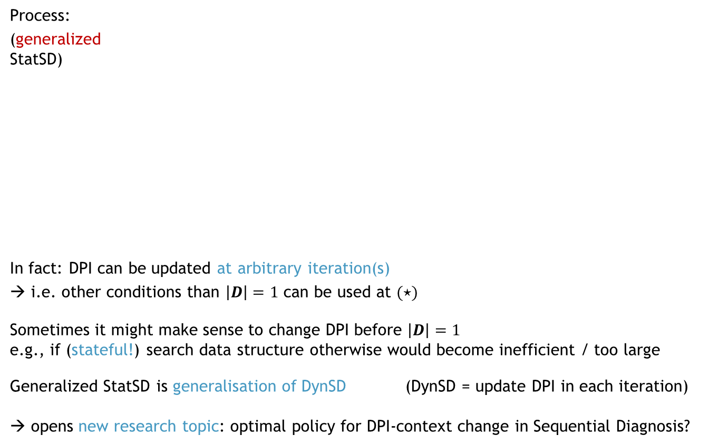





Search Space Restriction + Completeness
$〈SD,COMPS,MEAS〉$ becomes
$〈SD,COMPS,MEAS∪\{m_{1},…,m_{k}\}〉$
update DPI
Process:
(generalized
StatSD)
In fact: DPI can be updated at arbitrary iteration(s)
→ i.e. other conditions than $\left|D\right|=1$ can be used at $(⋆)$
Sometimes it might make sense to change DPI before $\left|D\right|=1$
e.g., if (stateful!) search data structure otherwise would become inefficient / too large
Generalized StatSD is generalisation of DynSD (DynSD = update DPI in each iteration)
→ opens new research topic: optimal policy for DPI-context change in Sequential Diagnosis?
updated DPI
$$\left(⋆\right) \left|D\right|=1 ∧ updated=F$$
DPI
compute diagnoses $D$
$$\left|D\right|=1$$
$$∧ updated=T$$
actually faulty components
$$updated=T$$
✔
$$D$$
update knowledge
compute measure-ment point $p_{i}$
$$updated=F$$
$$m_{i}$$
ask oracle
$$p_{i}$$
completeness?

Slide 15
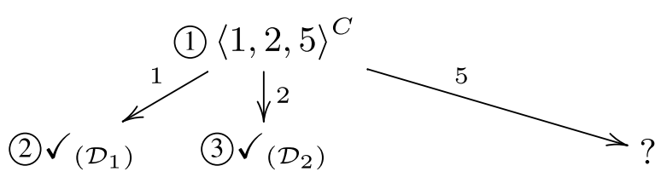
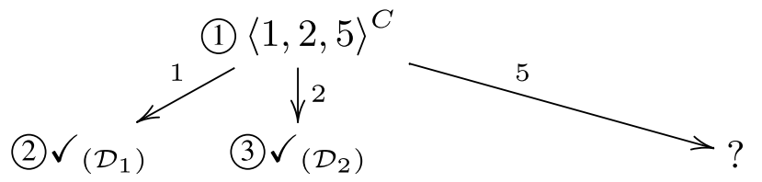
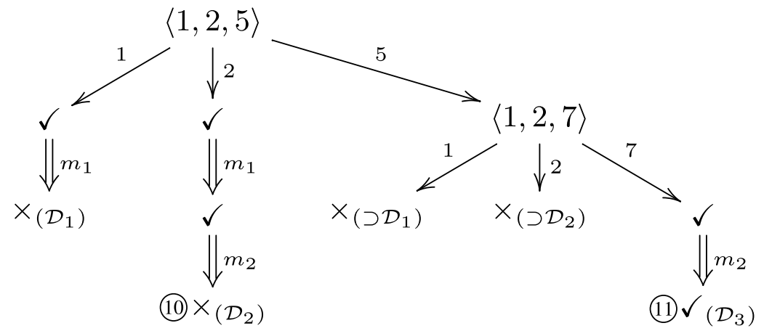
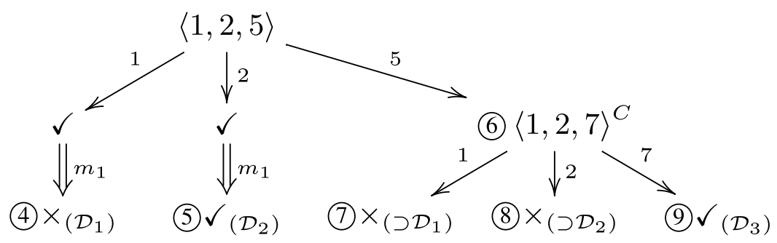
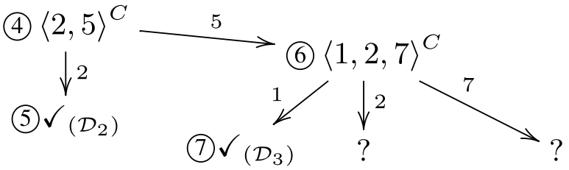
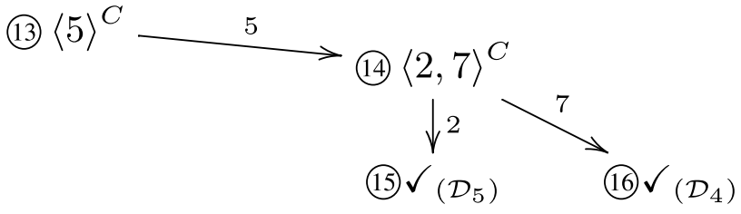
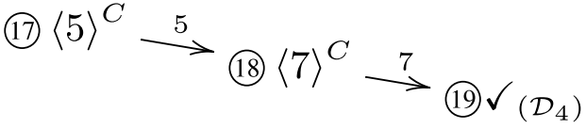
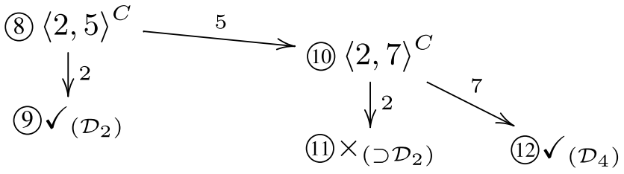






StaticHS: Stateful Diagnoses Search for StatSD
We propose StaticHS, an adaptation of Reiter‘s Hitting Set Tree (HS-Tree), that is
stateful (keeps state between iterations)
a procedure to solve (generalized) StatSD
as generally applicable (wrt.: systems, modeling languages, inference engines) as HS-Tree
Example (Solving StatSD vs. DynSD):
Given DPI $dpi_{0}$: $COMPS=\{1,…,7\}$, conflicts $〈1,2,5〉, 〈1,2,7〉$, actual diagnosis $\left[5,7\right]$
take measurement whenever 2 diagnoses are computed
StaticHS
Algo for DynSD (HS-Tree, build+discard)
4 measurements!
2 measurements!
actual diagnosis found
measurement $m_{4}$ → $MEAS∪\{m_{1},m_{2},m_{3},m_{4}\}$
measurement $m_{1}$ → $MEAS∪\{m_{1}\}$
measurement $m_{1}$ → $dpi_{0}+\{m_{1}\}$
measurement $m_{3}$ → $MEAS∪\{m_{1},m_{2},m_{3}\}$
measurement $m_{2}$ → $dpi_{0}+\{m_{1},m_{2}\}$
measurement $m_{2}$ → $MEAS∪\{m_{1},m_{2}\}$
actual diagnosis found

Slide 16


Evaluation (StatSD vs. DynSD)
actual diagnosis = random diagnosis (any DPI)
actual diagnosis = random diagnosis for $dpi_{0}$
143
49
1300
1781
143
49
1300
1781
48
90
1782
864
48
90
1782
864
DPI
$$|COMPS|$$
$\#$ of diagnoses for DPI ($dpi_{0}$)

Slide 17
Conclusions + Future Work
Contributions:
New definition of Sequential Diagnosis Problem → (generalized) StatSD
→ more general than the usual problem definition
New hitting set search algorithm (StaticHS) to solve (generalized) StatSD
→ diagnoses search space reduction + preservation of completeness
Evaluation results:
Solving generalized StatSD compared to usual SD problem
→ saves
  on avg.: 20%
  max: 65%
of the sequential diagnosis effort (# of measurements)
leads to less/equal/more effort in 76%/21%/3% of the cases
Future Work:
Research on when to optimally switch DPI-context in sequential diagnosis

