Slide 1
Test-Driven Ontology
Development in Protégé
ICBO’18
Konstantin Schekotihin, Patrick Rodler, Wolfgang Schmid
University of Klagenfurt
Matthew Horridge, Tania Tudorache
Stanford University

Slide 2
Test-Driven Development
Test-driven development (TDD) is popular in software engineering
We propose
  a (logic-based) TDD methodology for ontology engineering
  a plug-in for Protégé (called OntoDebug) to put this methodology into practice
Our vision/hope:
  to assist knowledge engineers / domain experts in the creation and
  maintenance of ontologies
  to help improve the quality of ontologies
define test case(s)
check if all satisfied
implement/ revise
re-iterate
(refactor)
Perform small,
frequent iterations!

Slide 3
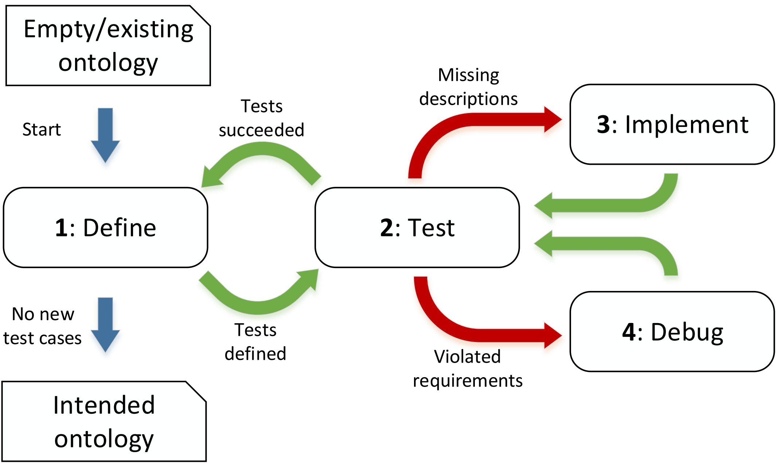
(Logic-based) TDD for Ontologies

Slide 4
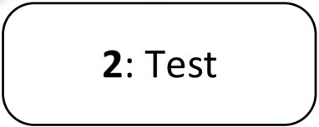
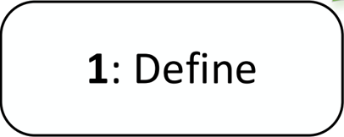


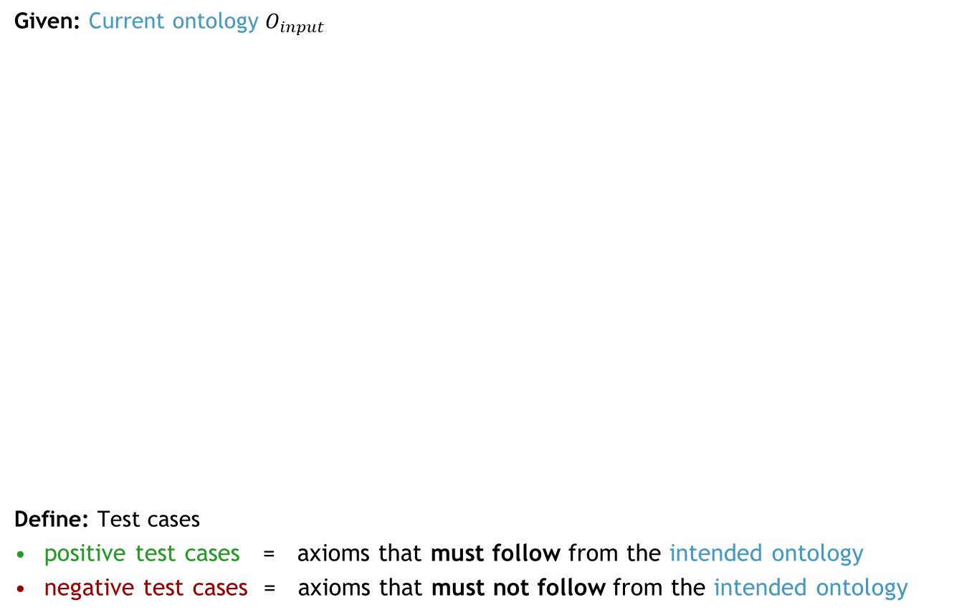
Test-Driven Development
Defining Properties of Desired Solution
Axioms
Given: Current ontology $O_{input}$
Define: Test cases
positive test cases = axioms that must follow from the intended ontology
negative test cases = axioms that must not follow from the intended ontology
axioms
that must be
entailed
Ontology $O_{input}$
axioms
that must not
be entailed
Domain expert: has
knowledge about the
intended ontology

Slide 5

Test-Driven Development
Verifying the defined Properties
Axioms
Given:
current ontology $O_{input}$
specified test cases
Verify: All specified test cases
satisfied by current ontology?
axioms that must
be logical
consequences
Ontology $O_{input}$
axioms that must
not be logical
consequences
lets us infer
?
✔
?
✔
does not let us infer
?
✔
?
✔
Case 1: all OK!

Slide 6
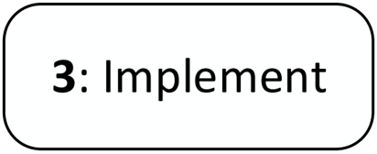
Test-Driven Development
Verifying the defined Properties
Axioms
Given:
current ontology $O_{input}$
specified test cases
Verify: All specified test cases
satisfied by current ontology?
axioms that must
be logical
consequences
Ontology $O_{input}$
axioms that must
not be logical
consequences
lets us infer
?
✖
?
✔
does not let us infer
?
✔
?
✔
Case 2: some positive test case(s) not satisfied!

Slide 7


Test-Driven Development
Extending the Ontology
Axioms
Given:
current ontology $O_{input}$
specified test cases
Implement: Add new axiom(s) to
the current ontology such that all
positive test cases are satisfied
Ontology $O_{input}$
axioms that must
be logical
consequences
Ontology $O_{new}$
axioms that must
not be logical
consequences
lets us infer
?
✖
✔
✔
does not let us infer
?
✔
?
✔
Case 2: some positive test case(s) not satisfied!
Case 1: all OK!

Slide 8
Example
Test-Driven Development
+
Ontology
B SubClassOf C
x Type C
x Type A
A SubClassOf D
A SubClassOf B

Slide 9
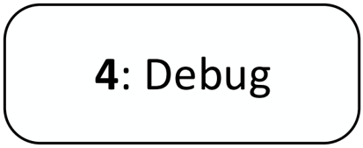
Test-Driven Development
Verifying the Defined Properties
Axioms
Given:
current ontology $O_{input}$
specified test cases
Verify: All specified test cases
satisfied by current ontology?
axioms that must
be logical
consequences
Ontology $O_{input}$
axioms that must
not be logical
consequences
lets us infer
?
✔
?
✔
does not let us infer
?
✔
?
✖
Case 3: some negative test case(s) not satisfied and/or
current ontology inconsistent/incoherent!

Slide 10
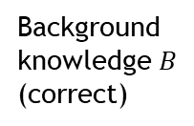
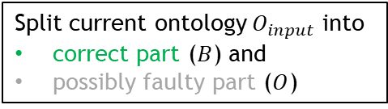
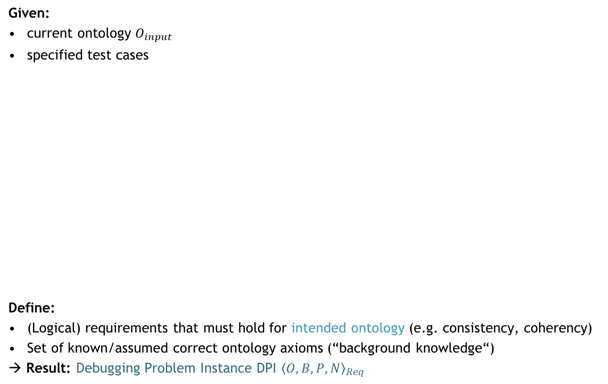




Ontology Debugging
Specifying Requirements / Focusing on Relevant Axioms
Ontology $O$
(possibly faulty)
Axioms
Given:
current ontology $O_{input}$
specified test cases
Define:
(Logical) requirements that must hold for intended ontology (e.g. consistency, coherency)
Set of known/assumed correct ontology axioms (“background knowledge“)
→ Result: Debugging Problem Instance DPI ${〈O,B,P,N〉}_{Req}$
Background
knowledge $B$
(correct)
axioms $P$
that must be
entailed
Ontology $O_{input}$
axioms $N$
that must not
be entailed
Search for faults only here!
requirements
$Req$ that must
be satisfied
Split current ontology $O_{input}$ into
correct part ($B$) and
possibly faulty part ($O$)

Slide 11
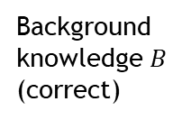
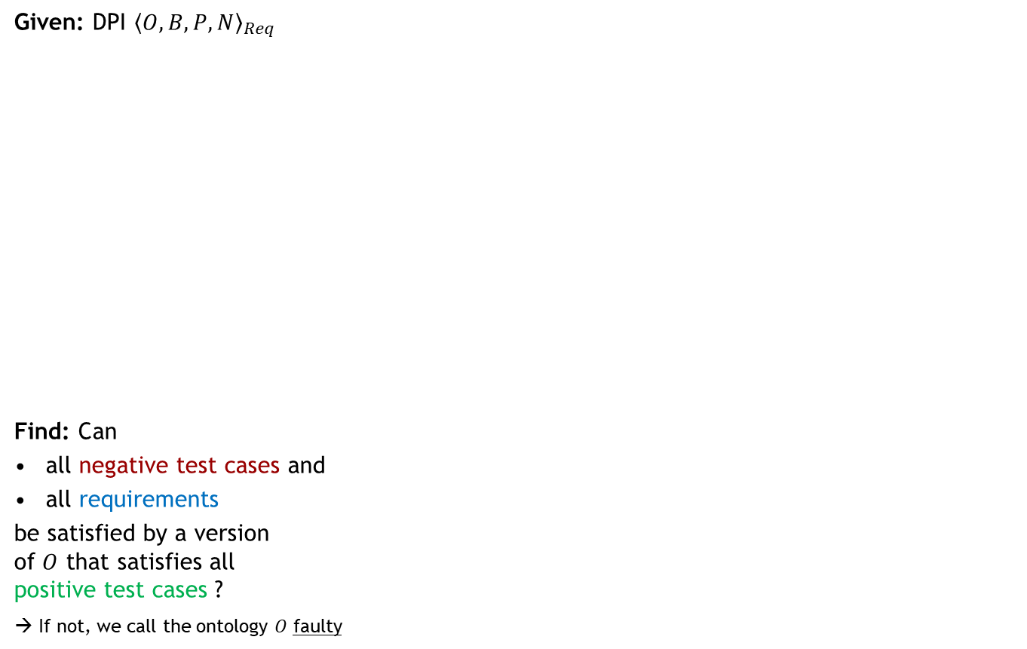
Ontology Debugging
Fault Detection Problem
Ontology $O$
(possibly faulty)
Axioms
Given: DPI ${〈O,B,P,N〉}_{Req}$
Find: Can
all negative test cases and
all requirements
be satisfied by a version
of $O$ that satisfies all
positive test cases ?
→ If not, we call the ontology $O$ faulty
axioms $P$
that must be
entailed
Background
knowledge $B$
(correct)
axioms $N$
that must not
be entailed
requirements
$Req$ that must
be satisfied
not entails any axiom in
not violates any property in

Slide 12
Example
Fault Detection
Axioms
A SubClassOf B
x Type A
B SubClassOf C
x Type not C
not entails any axiom in?
not entails any axiom in?
A SubClassOf C
not violates any property in?
not violates any property in?
consistency

Slide 13

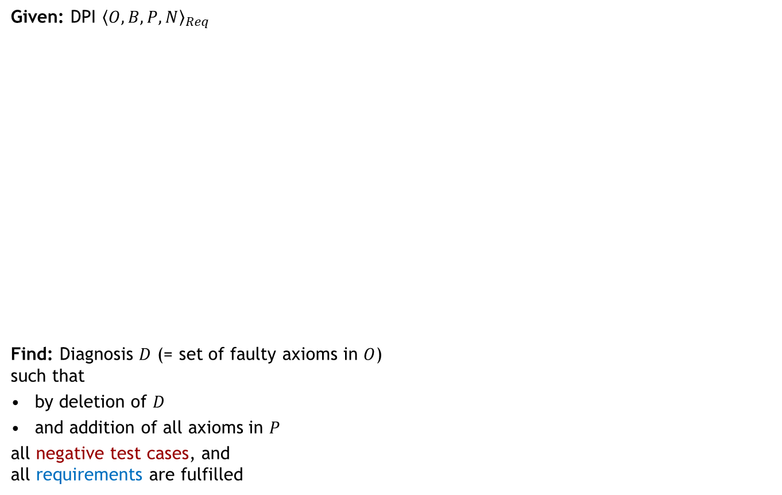



Ontology Debugging
Fault Localization Problem (1) – Finding a Diagnosis
Axioms
Ontology $O$
(possibly faulty)
Given: DPI ${〈O,B,P,N〉}_{Req}$
Find: Diagnosis $D$ (= set of faulty axioms in $O$)
such that
by deletion of $D$
and addition of all axioms in $P$
all negative test cases, and
all requirements are fulfilled
axioms $P$
that must be
entailed
Background
knowledge $B$
(correct)
axioms $N$
that must not
be entailed
$$D$$
$$D$$
requirements
$Req$ that must
be satisfied
Note: In OntoDebug diagnoses are called “repairs“
not entails
any axiom in
not violates
any property in

Slide 14









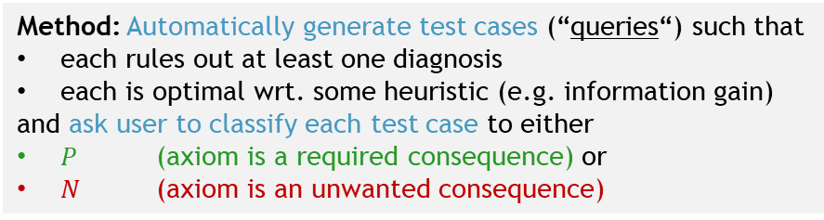



Ontology Debugging
Fault Localization Problem (2) – Finding correct diagnosis
Diagnosis with correct semantics
Any two diagnoses
lead to a
repaired ontology with different semantics
Axioms
Ontology $O$
(possibly faulty)
Given: DPI ${〈O,B,P,N〉}_{Req}$
multiple diagnoses $D_{1},…,D_{k}$
Find: The diagnosis $D^{∗}$ with the
correct semantics among $D_{1},…,D_{k}$
How?
Specify additional test case(s) to
discriminate among diagnoses
Manually?
Yes → if the user so desires
BUT → not easy to find “good“ test cases
$$D_{2}$$
$$D_{1}$$
axioms $P$
that must be
entailed
Background
knowledge $B$
(correct)
$$D_{3}$$
$$D_{6}$$
$$D_{4}$$
$$D_{5}$$
axioms $N$
that must not
be entailed
$$D_{7}$$
Generally, there are exponentially many competing diagnoses
$$D_{k}$$
…
requirements
$Req$ that must
be satisfied
Method: Automatically generate test cases (“queries“) such that
each rules out at least one diagnosis
each is optimal wrt. some heuristic (e.g. information gain)
and ask user to classify each test case to either
$P$ (axiom is a required consequence) or
$N$ (axiom is an unwanted consequence)
Yes!
No!
query
OntoDebug
answer

Slide 15



Example
Fault Localization
$$D_{1}$$
Axioms
Note:
For x Type B
$D_{2}$ (logically) “predicts“ the positive query answer!
$D_{1}$ (logically) “predicts“ the negative query answer!
x Type not C
A SubClassOf B
x Type A
B SubClassOf C
A SubClassOf C
$$D_{2}$$
consistency
x Type B ?
OntoDebug
x Type B
yes!

Slide 16











Ontology Debugging
Fault Identification and Repair Problem (1)
Given: actual diagnosis $D^{∗}=\{ax_{1},…,ax_{n}\}$
Find: repaired diagnosis $D_{rep}^{∗}=\left\{ax_{1}^{′},…,ax_{n}^{′}\right\}$ where $ax_{i}^{′}$ is the repaired version of $ax_{i}$
such that
$O$ including $ax_{1}^{′},…,ax_{n}^{′}$ instead of $ax_{1},…,ax_{n}$ is not faulty
(Note: repair of axiom might also be simply its deletion)
Ontology $O$
(possibly faulty)
$$D_{rep}^{∗}$$
$$D^{∗}$$
$$ax_{2}$$
$$ax_{1}$$
$$ax_{2}^{′}$$
$$ax_{1}^{′}$$
Background
knowledge $B$
(correct)
$$…$$
$$ax_{n}$$
$$ax_{n}^{′}$$

Slide 17


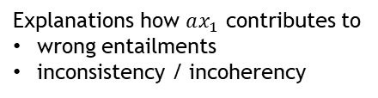
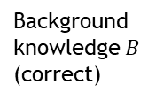

Ontology Debugging
Fault Identification and Repair Problem (2)
Explanations how $ax_{1}$ contributes to
wrong entailments
inconsistency / incoherency
Given: actual diagnosis $D^{∗}=\{ax_{1},…,ax_{n}\}$
Find: repaired diagnosis $D_{rep}^{∗}=\left\{ax_{1}^{′},…,ax_{n}^{′}\right\}$
How?
For each problem caused by $ax_{i}$ show the user justifications (why is the problem present?)
User can try various modifications $ax_{i}^{′}$ of $ax_{i}$ (on a virtual copy of the ontology) and can
  directly check if some modification $ax_{i}^{′}$ solves all problems and
  see which problems persist
Changes written back to original ontology only after user has confirmed all alterations
Ontology $O$
(possibly faulty)
$$D^{∗}$$
$$ax_{2}$$
violates
Background
knowledge $B$
(correct)
$$ax_{1}$$
$$…$$
$$ax_{n}$$
violates
violates

Slide 18
Example
Fault Identification and Repair
Axioms
x Type not C
A SubClassOf B
x Type B
x Type A
B SubClassOf C
A SubClassOf C
consistency
Typo!
Explanation 1
Explanation 2
Explanation 3
B SubClassOf D

Slide 19
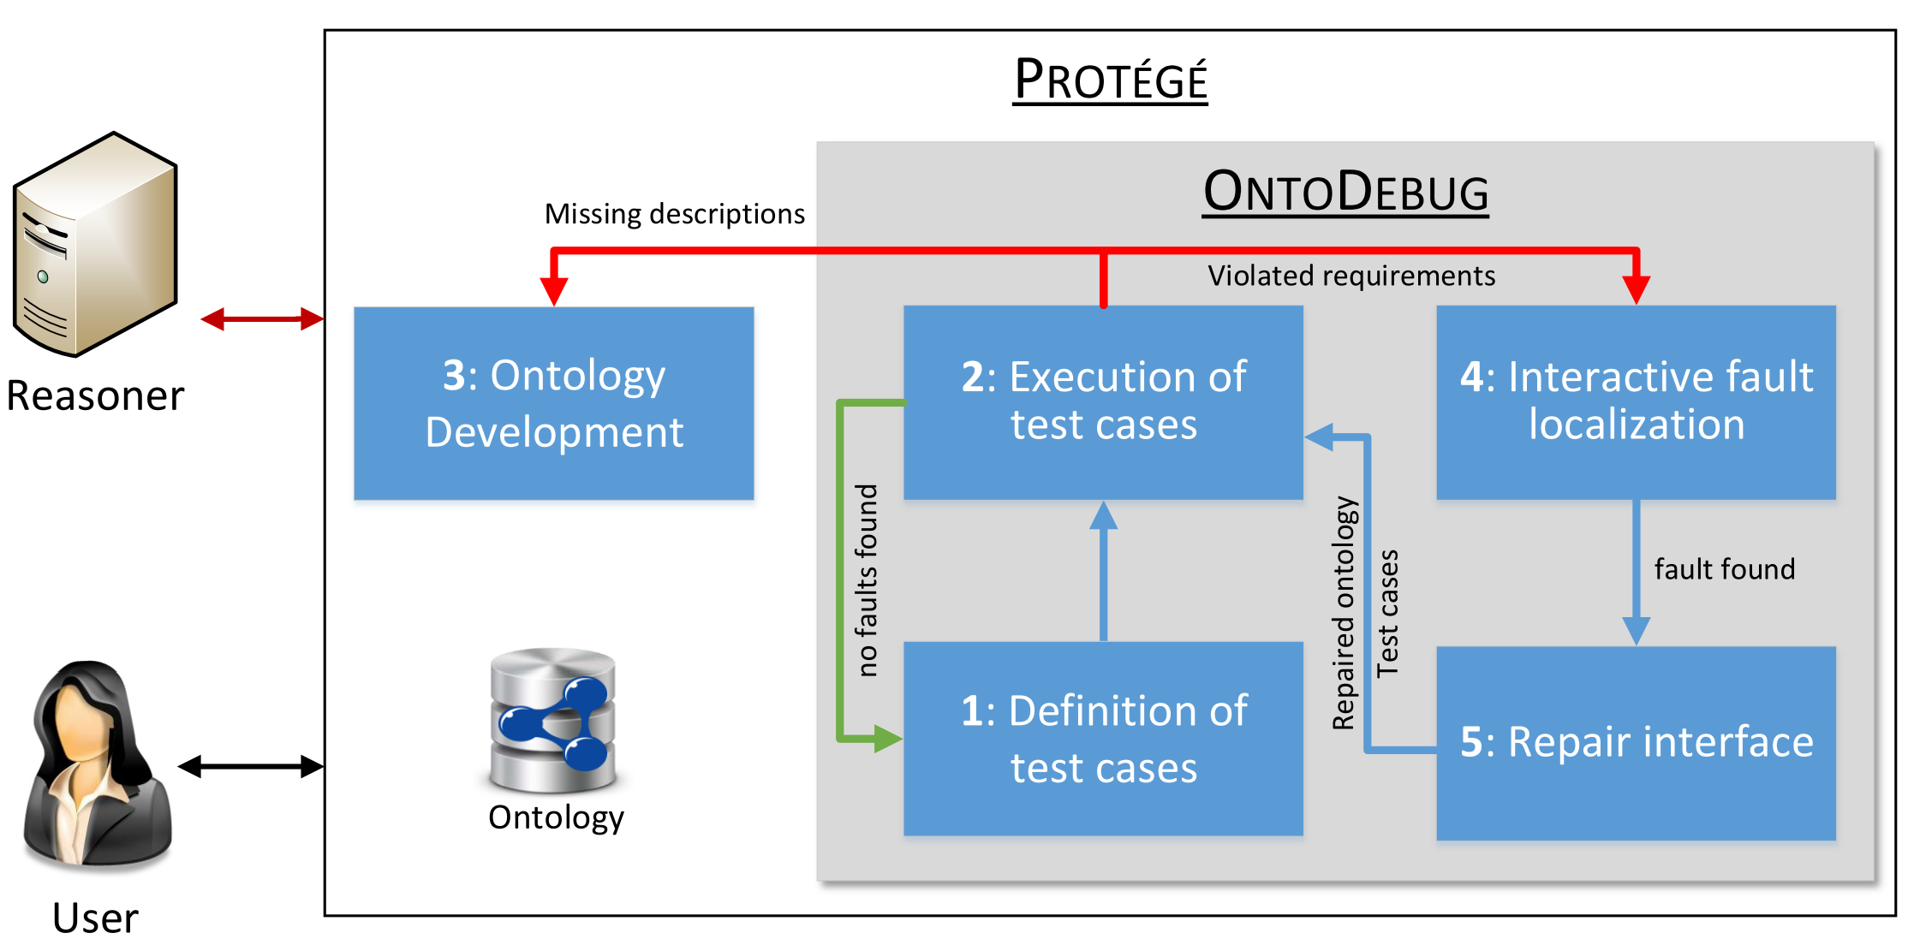
Test-Driven Development + Debugging with OntoDebug

Slide 20
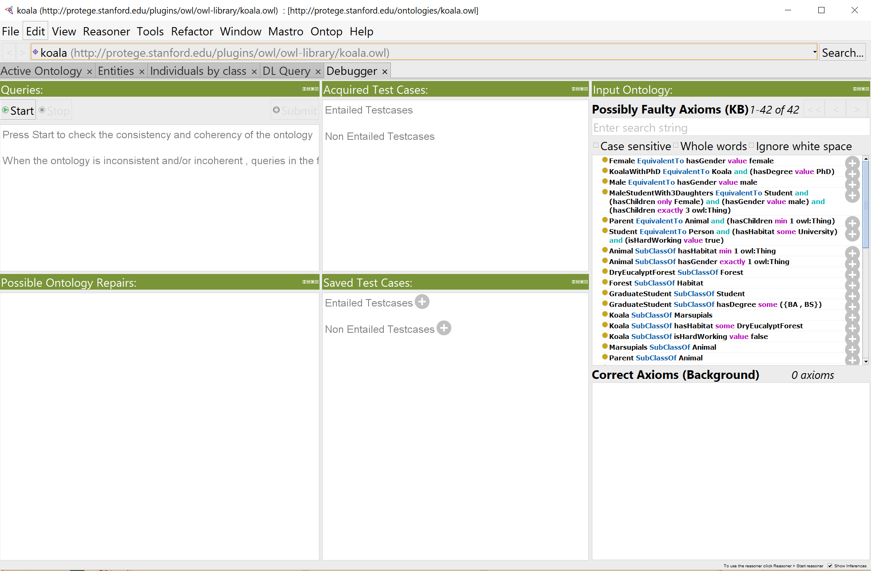
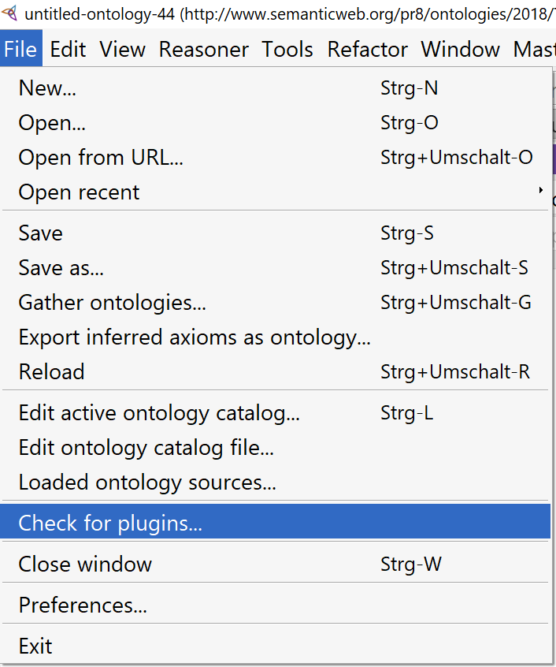
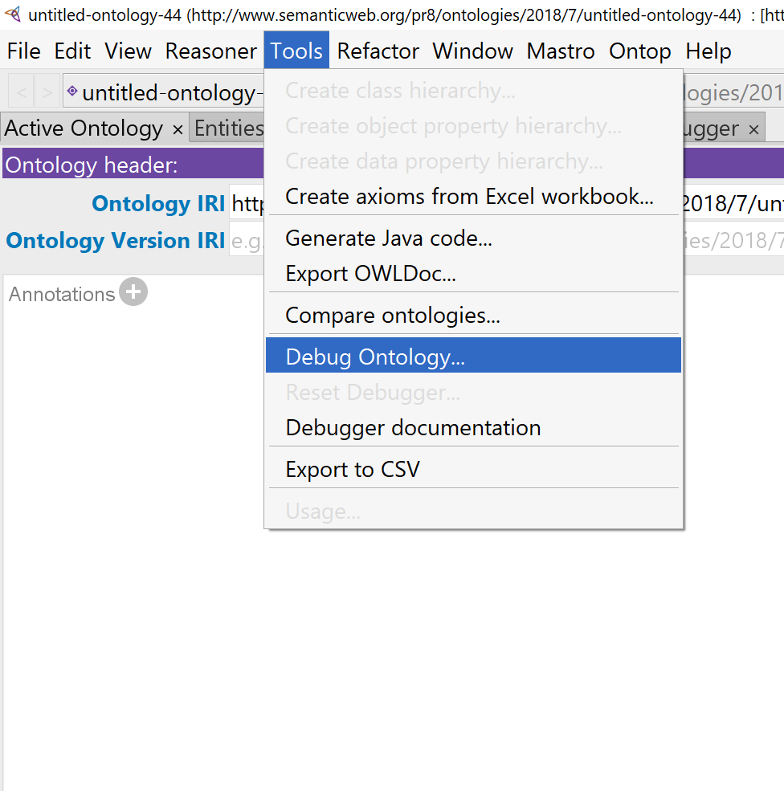
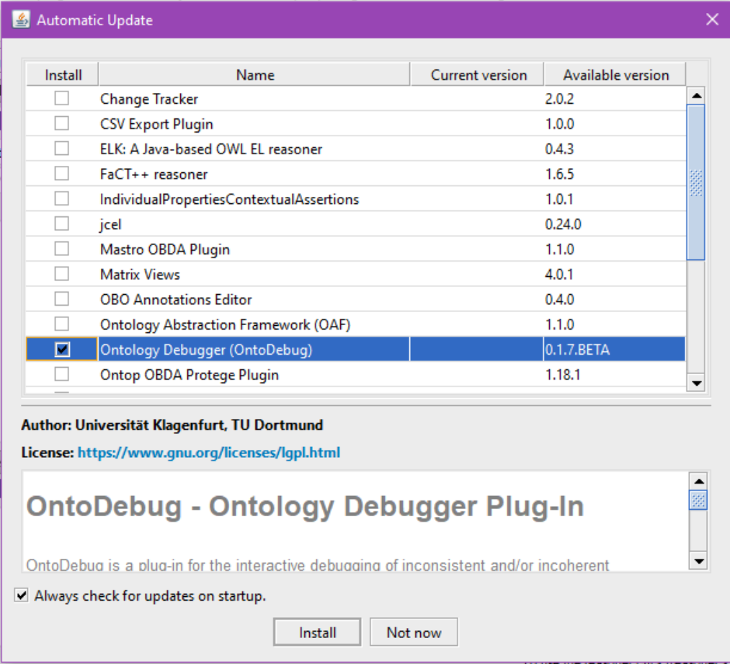
OntoDebug
Comes directly with Protégé 5.* (not compatible with Protégé 4.* or earlier)
Can use different reasoners in a simple plug-in fashion
  Pellet, HermiT, ELK, etc.
  use fastest / most adequate reasoner for your problem
Customizable fault candidate computation
  smallest faults first, most probable faults first
  strategies for handling problems with large-sized faults (e.g. aligned ontologies)
  optimizations wrt. computation time (parallelization, intelligent search techniques)
Different optimizations wrt. the minimization of the user effort to find fault
  strategies for minimizing the user‘s waiting time between two questions
  strategies minimizing the number of questions to the user
  asking the user the easiest / shortest / (best-user-expertise-matching) questions
  simplification of explanations
More to come… …so stay tuned!

Slide 21
Demo
http://isbi.aau.at/ontodebug/images/ontodebug_in_action.gif

Slide 22
Future Work
Goals:
Fine-tune / improve OntoDebug to serve users best
Integrate support for further efficient + useful methodologies for
ontology development / debugging / quality assurance
However, to this end, we need:
REAL USERS to understand their needs / preferences / problems
Faulty REAL-WORLD ontologies to test / evaluate our strategies

Slide 23

Summary
Thank you for your attention!
Konstantin Schekotihin, Patrick Rodler, Wolfgang Schmid
University of Klagenfurt
Matthew Horridge, Tania Tudorache
Stanford University
patrick.rodler@aau.at
Test-driven development and debugging for ontologies
OntoDebug supplements Protégé with a support for
test-driven ontology development
interactive ontology debugging
Given ontology $O$, OntoDebug provides support for interacting user (e.g. biologist, medical expert) for
specifying which requirements and test cases $O$ must meet
checking $O$ for fulfillment of the specifications, and if faulty
locating and
repairing
the faulty axioms responsible for $O$‘s defectiveness
You can find everything about OntoDebug under http://isbi.aau.at/ontodebug/
Give it a try! ☺

Slide 24
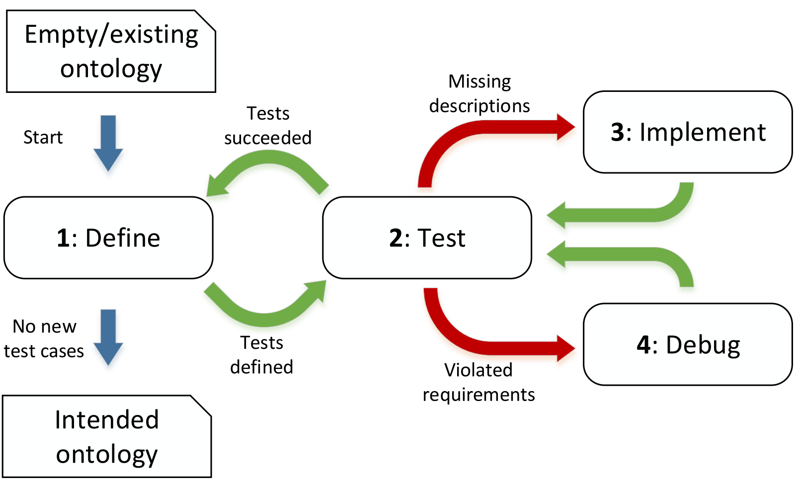
TD Development & Debugging – Summary
required logical conse-quences
Test Case Verifier
unwanted
logical
conse-
quences
all OK?
Interactive Debugger
query
possible faults
actual fault
faulty axioms
Axioms
answer
rectify/delete axiom
formulate new axioms
show ex-
planation
Ontology
Interactive Repair
analyze axiom
Notes:
Test-driven ontology development
(Interactive) Debugging
Repair

Slide 25
Future Work
We are actively researching on
ever more efficient + useful methodologies for
ontology development / debugging / quality assurance
However, to this end, we need:
REAL USERS to understand their needs / preferences / problems
Faulty REAL-WORLD ontologies to test / evaluate our strategies

Slide 26
Research on Ontology Engineering + Debugging
We are actively researching for
ever more efficient + useful ways of debugging ontologies
However, to this end, we need:
REAL USERS to understand their needs / preferences / problems
We need faulty REAL-WORLD ontologies to test / evaluate our strategies
In short:
We need YOU!

