Slide 1
OntoDebug: Interactive Ontology
Debugging Plug-In for Protégé
FoIKS’18
Konstantin Schekotihin, Patrick Rodler, Wolfgang Schmid ©

Slide 2
Agenda
Motivation
OntoDebug: Overview
Ontology Debugging Problem
  Subproblems
  How OntoDebug addresses them
  Examples
Ontology Evolution using OntoDebug
OntoDebug: Features
Demo

Slide 3
Motivation
Many (semantic web) applications using ontologies
providing services in often critical fields
e.g. biomedicine (SNOMED, NCI-T, OBO Foundry)
  ontologies of tremendous size (100.000s of terms + axioms)
  formalizing sensitive medical knowledge (e.g. cancer therapies)
  used in eHealth applications (e.g. patient health records)
Faults in ontologies (e.g. wrong logical consequences) can have severe consequences
e.g. suggesting the wrong medication for a cancer patient
(Manual) Ontology Debugging is hard given KBs that are
large in size
represented in expressive logics
developed by multiple people or in distributed fashion
(partially) generated by means of automatic systems
→ Tool assistance required!

Slide 4
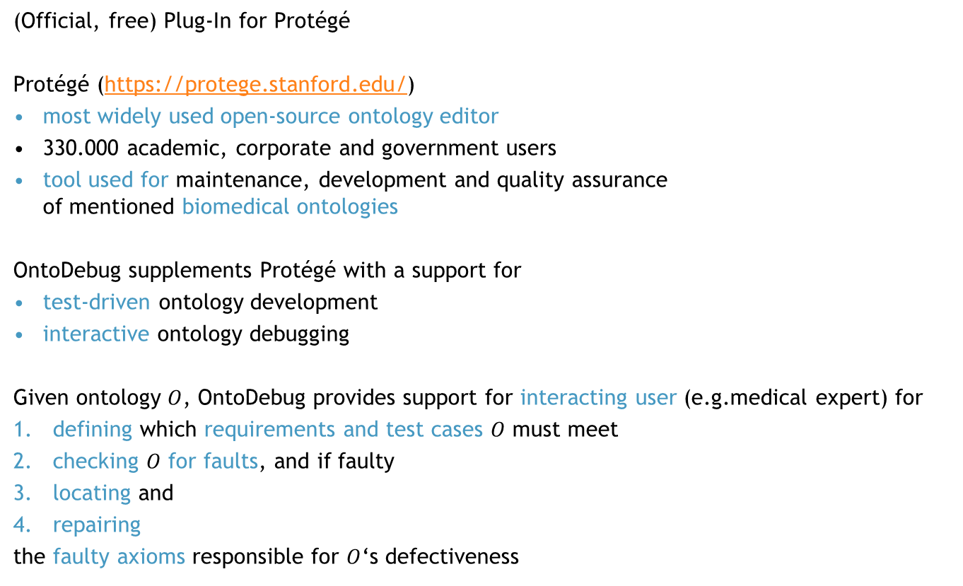
Our Solution: OntoDebug
(Official, free) Plug-In for Protégé
Protégé (https://protege.stanford.edu/)
most widely used open-source ontology editor
330.000 academic, corporate and government users
tool used for maintenance, development and quality assurance
of mentioned biomedical ontologies
OntoDebug supplements Protégé with a support for
test-driven ontology development
interactive ontology debugging
Given ontology $O$, OntoDebug provides support for interacting user (e.g.medical expert) for
defining which requirements and test cases $O$ must meet
checking $O$ for faults, and if faulty
locating and
repairing
the faulty axioms responsible for $O$‘s defectiveness

Slide 5
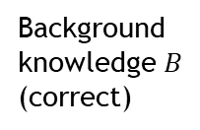
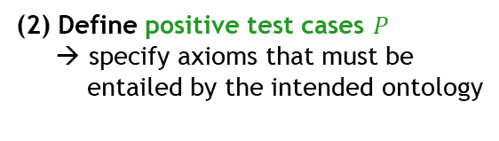


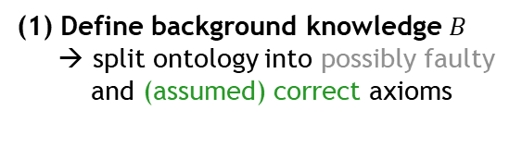



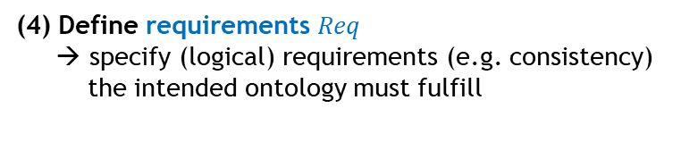

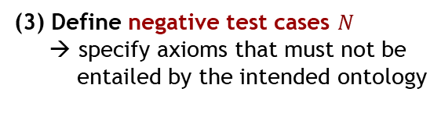
Ontology Debugging / Test-Driven Development
Defining the Problem and Properties of the desired Solution
Ontology $O$
(possibly faulty)
Axioms
Given: Ontology $O_{input}$
Define:
Debugging Problem Instance
DPI ${〈O,B,P,N〉}_{Req}$
axioms $P$
that must be
entailed
Background
knowledge $B$
(correct)
Ontology $O_{input}$
axioms $N$
that must not
be entailed
requirements
$Req$ that must
be satisfied
(1) Define background knowledge $B$
→ split ontology into possibly faulty
and (assumed) correct axioms
(2) Define positive test cases $P$
→ specify axioms that must be
entailed by the intended ontology
(3) Define negative test cases $N$
→ specify axioms that must not be
entailed by the intended ontology
(4) Define requirements $Req$
→ specify (logical) requirements (e.g. consistency)
the intended ontology must fulfill

Slide 6
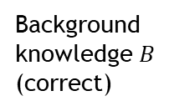

Ontology Debugging
Fault Detection Problem
Ontology $O$
(possibly faulty)
Axioms
Given: DPI ${〈O,B,P,N〉}_{Req}$
Find: Does $O∪B∪P$ meet
all negative test cases,
all requirements ?
→ We call the ontology $O$ faulty if it does not meet test cases or requirements
axioms $P$
that must be
entailed
Background
knowledge $B$
(correct)
axioms $N$
that must not
be entailed
requirements
$Req$ that must
be satisfied
not entails any axiom in
not violates any property in

Slide 7
Example
Fault Detection Problem
Axioms
A SubClassOf B
x Type A
B SubClassOf C
x Type not C
not entails any axiom in?
not entails any axiom in?
A SubClassOf C
not violates any property in?
not violates any property in?
consistency

Slide 8

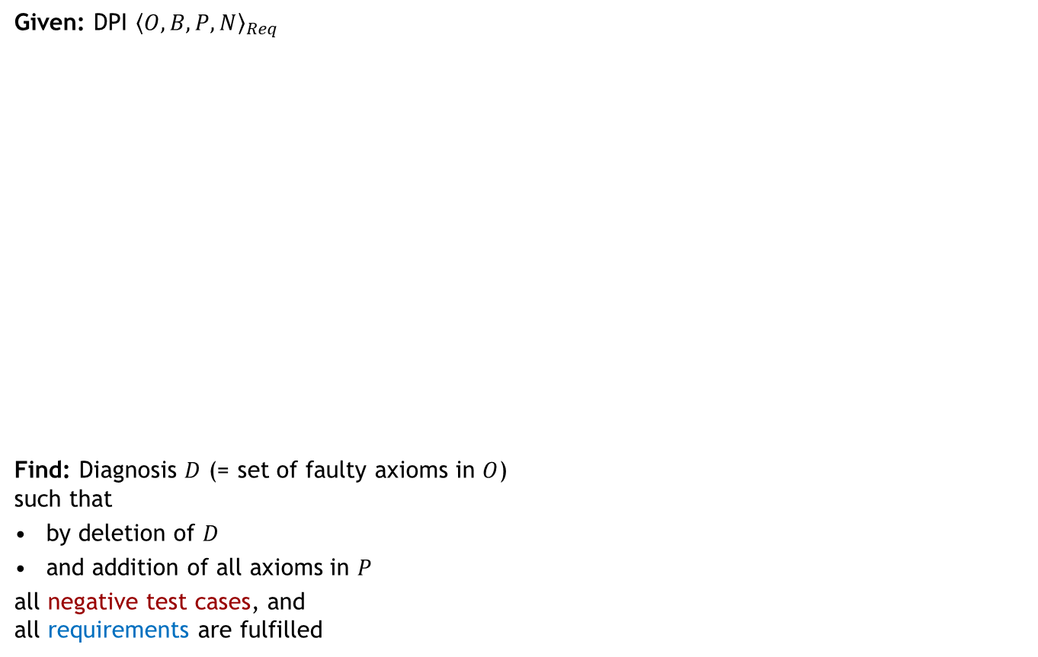



Ontology Debugging
Fault Localization Problem (1) – Finding a diagnosis
Axioms
Ontology $O$
(possibly faulty)
Given: DPI ${〈O,B,P,N〉}_{Req}$
Find: Diagnosis $D$ (= set of faulty axioms in $O$)
such that
by deletion of $D$
and addition of all axioms in $P$
all negative test cases, and
all requirements are fulfilled
axioms $P$
that must be
entailed
Background
knowledge $B$
(correct)
axioms $N$
that must not
be entailed
$$D$$
$$D$$
requirements
$Req$ that must
be satisfied
Note: In OntoDebug diagnoses are called “repairs“
not entails
any axiom in
not violates
any property in

Slide 9


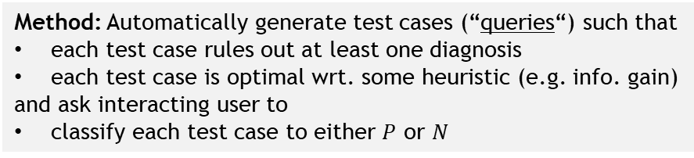











Ontology Debugging
Fault Localization Problem (2) – Finding the correct diagnosis
Diagnosis with correct semantics
Any two diagnoses
lead to a
repaired ontology with different semantics
Axioms
Ontology $O$
(possibly faulty)
Given: DPI ${〈O,B,P,N〉}_{Req}$
multiple diagnoses $D_{1},…,D_{k}$
Find: The diagnosis $D^{∗}$ with the
correct semantics among $D_{1},…,D_{k}$
How?
Specify additional test case(s) to
discriminate among diagnoses
Manually?
Yes → if the user wants to
BUT → not easy to find “good“ test cases
$$D_{2}$$
$$D_{1}$$
axioms $P$
that must be
entailed
Background
knowledge $B$
(correct)
$$D_{3}$$
$$D_{6}$$
$$D_{4}$$
$$D_{5}$$
axioms $N$
that must not
be entailed
$$D_{7}$$
Generally, there are exponentially many competing diagnoses for a DPI
$$D_{k}$$
…
requirements
$Req$ that must
be satisfied
Method: Automatically generate test cases (“queries“) such that
each test case rules out at least one diagnosis
each test case is optimal wrt. some heuristic (e.g. info. gain)
and ask interacting user to
classify each test case to either $P$ or $N$
query
OntoDebug
answer

Slide 10



Example
Fault Localization Problem
$$D_{1}$$
Axioms
Note:
x Type B is
an entailment of the ontology ($O∪B∪P$) after deleting $D_{2}$
→ $D_{2}$ “predicts“ the positive query answer!
inconsistent with the ontology ($O∪B∪P$) after deleting $D_{1}$
→ $D_{1}$ “predicts“ the negative query answer!
x Type not C
A SubClassOf B
x Type A
B SubClassOf C
A SubClassOf C
$$D_{2}$$
consistency
x Type B ?
OntoDebug
x Type B
yes!

Slide 11











Ontology Debugging Problem
Fault Identification and Repair Problem (1)
Given: actual diagnosis $D^{∗}=\{ax_{1},…,ax_{n}\}$
Find: repaired diagnosis $D_{rep}^{∗}=\left\{ax_{1}^{′},…,ax_{n}^{′}\right\}$ where $ax_{i}^{′}$ is the repaired version of $ax_{i}$
such that
$O$ including $ax_{1}^{′},…,ax_{n}^{′}$ instead of $ax_{1},…,ax_{n}$ is not faulty
(Note: repair of axiom might also be simply its deletion)
Ontology $O$
(possibly faulty)
$$D_{rep}^{∗}$$
$$D^{∗}$$
$$ax_{2}$$
$$ax_{1}$$
$$ax_{2}^{′}$$
$$ax_{1}^{′}$$
Background
knowledge $B$
(correct)
$$…$$
$$ax_{n}$$
$$ax_{n}^{′}$$

Slide 12



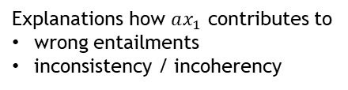
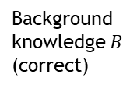
Ontology Debugging Problem
Fault Identification and Repair Problem (2)
Explanations how $ax_{1}$ contributes to
wrong entailments
inconsistency / incoherency
Given: actual diagnosis $D^{∗}=\{ax_{1},…,ax_{n}\}$
Find: repaired diagnosis $D_{rep}^{∗}=\left\{ax_{1}^{′},…,ax_{n}^{′}\right\}$
How?
For each problem caused by $ax_{i}$ show the user justifications (why is the problem present?)
User can try various modifications $ax_{i}^{′}$ of $ax_{i}$ (on a virtual copy of the ontology) and can
  directly check if some $ax_{i}^{′}$ solves all problems and
  see which problems persist
Changes written back to original ontology only after user has confirmed all alterations
Ontology $O$
(possibly faulty)
$$D^{∗}$$
$$ax_{2}$$
violates
Background
knowledge $B$
(correct)
$$ax_{1}$$
$$…$$
$$ax_{n}$$
violates
violates

Slide 13
Example
Fault Identification and Repair Problem
Axioms
x Type not C
A SubClassOf B
x Type B
x Type A
B SubClassOf C
A SubClassOf C
consistency
Typo!
Explanation 1
Explanation 2
Explanation 3
B SubClassOf D

Slide 14
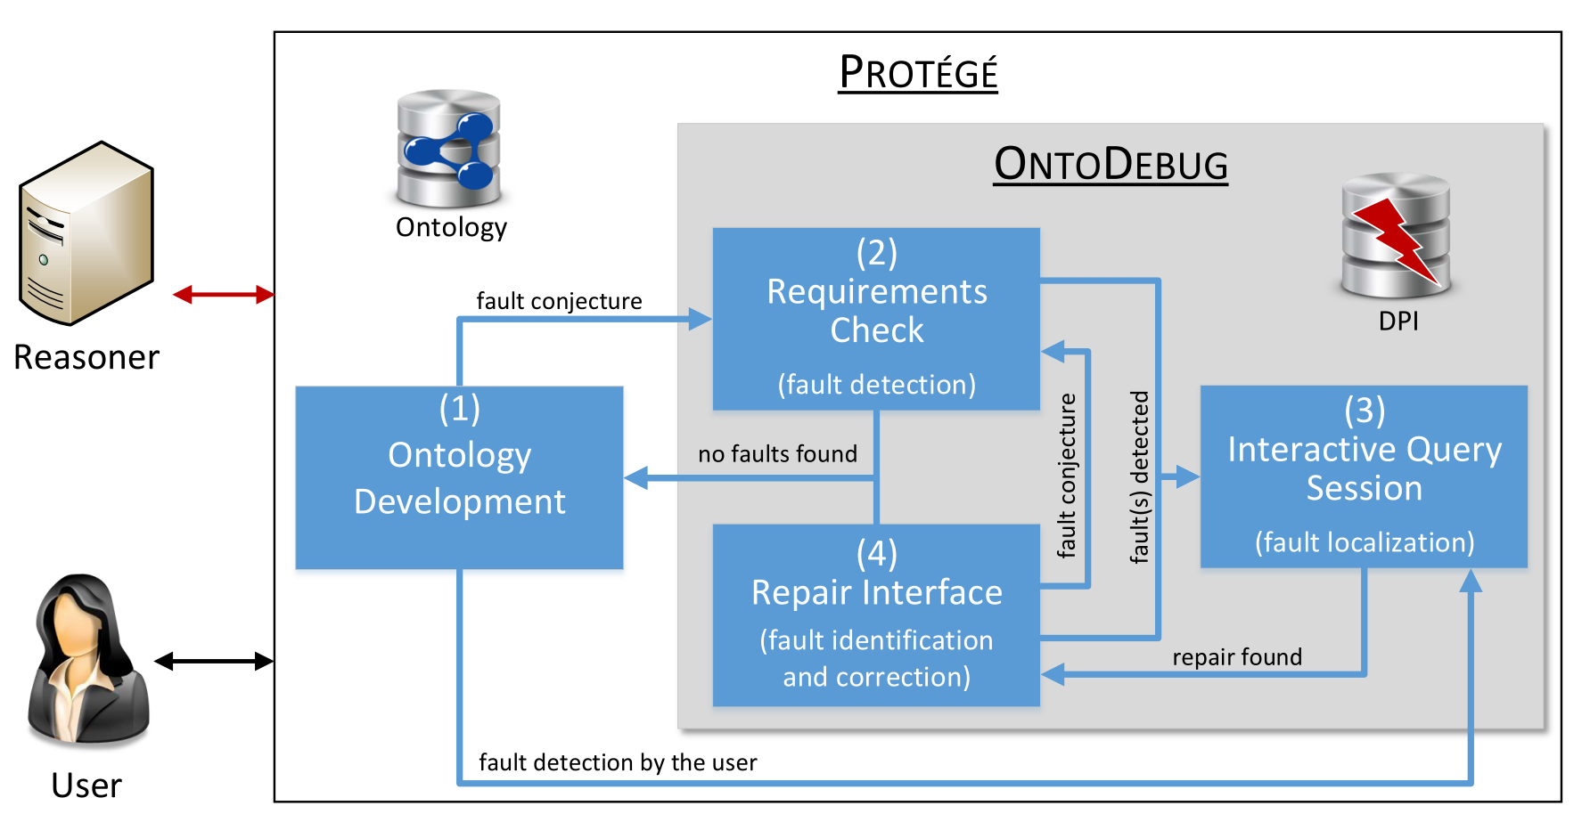
Ontology Evolution using OntoDebug
(1) Ontology Development in Protégé
adding, deleting, modifying axioms
computing entailments, checking justifications of entailments (why entailments hold)
if user conjectures / finds a fault, go to (2) Fault Detection / (3) Fault Localization

Slide 15
Ontology Evolution using OntoDebug
(2) Fault Detection (is there a fault?)
check if ontology satisfies all specified requirements and test cases
if OK, go back to (1) Ontology Development
else, go to (3) Fault Localization

Slide 16
Ontology Evolution using OntoDebug
(3) Fault Localization (where is the fault?)
find the set of ontology axioms responsible for the problems
interact with the user using queries to collect the information needed
once only 1 solution left (or user recognizes the solution), go to (4) Fault Identification

Slide 17
Ontology Evolution using OntoDebug
(4) Fault Identification and Correction (what is the fault and how to correct it?)
assist the user in the axiom repair process
user can check (consequences of) different modifications on virtual copy of ontology
once user is satisfied, modifications are applied to ontology

Slide 18
OntoDebug: Features (Overview) 1
reasoner is incorporated as-is for consistency / entailment checks
different reasoners usable in simple plug-in fashion
→ can use fastest reasoner for given ontology
can directly benefit from latest advances in reasoning research
Fault Localization:
various black-box algorithms
direct vs. indirect diagnoses search
  direct: depth-first → linear space complexity, not best-first,
  can handle high-cardinality faults
  indirect: uniform-cost search → exponential space complexity, best-first, tends to be
  faster than direct for normal (rather small-sized) faults
  coming soon:
  staticHS: stateful variant of indirect → powerful search-space restriction,
  significant minimization of user effort
  dynamicHS: stateful variant of indirect → powerful search tree pruning
different algorithms for computing minimal faulty sub-ontologies (aka “conflicts“)
  QuickXPlain: divide+conquer → good stable performance when reasoning rather fast
  MergeXPlain: variant of QuickXPlain → multiple (disjoint) conflicts, easily parallelizable
  Progression: geometric progression-based minimization → best choice when reasoning hard
Fault Identification + Repair: automatic simplification of explanations (“laconic“ versions)
e.g. smallest or
most-probable
faults first

Slide 19
OntoDebug: Features (Overview) 2
Query Computation + Selection:
highly efficient reasoner-free query computation + optimization
query enrichment + optimization for
  easier-to-understand queries
  queries matching user‘s expertise
different query selection heuristics
  entropy: queries with best information gain → good if high-quality prior probabilities are given
  split-in-half: queries which eliminates ½ of (known) diagnoses → good if low-quality priors
  dynamic: reinforcement learning selection → reasonable performance for any priors
  more to come …
preferences on query properties:
  fewest axioms
  lowest expected answering time
  easiest to answer

Slide 20
Demo

Slide 21

Thank you for your attention!
Questions?
You can find everything about OntoDebug under http://isbi.aau.at/ontodebug/
Give it a try! ☺

