Slide 1
Don't Treat the Symptom,
Find the Cause!
Efficient AI Methods for
(Interactive) Debugging
TeWi Kolloquium, October 2022
Patrick Rodler

Slide 2
Agenda
General Introduction
  Model-based diagnosis / Sequential diagnosis
  Objectives
  Applications
  Related research areas
  Generic model-based diagnosis system (overview + modules + challenges)
Our Research: Overview
Our Research: Selected Works
Our Research: Summary of (Main) Results
Conclusion + Outlook
Appendix: Further Selected Works

Slide 3
Introduction

Slide 4
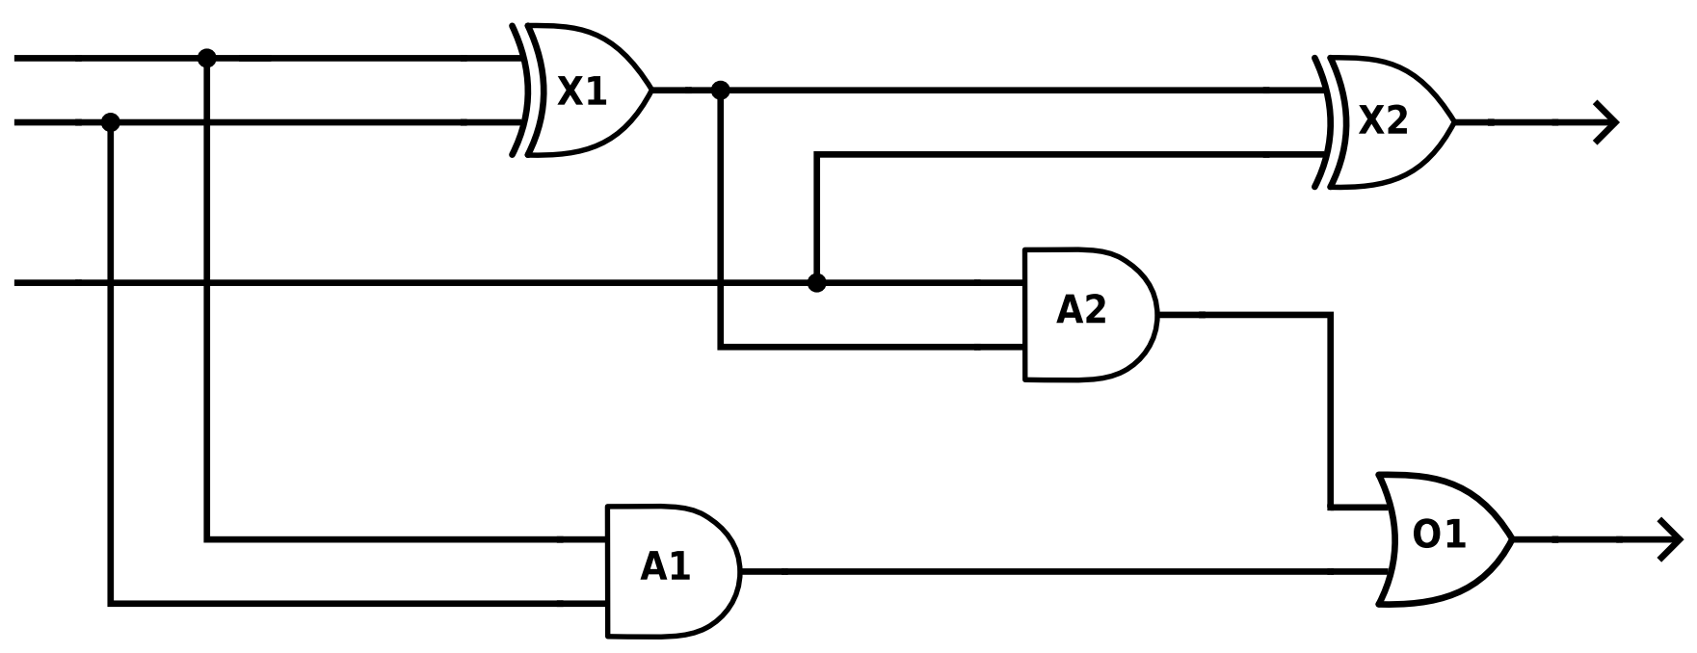







Model-Based Diagnosis
Often: only minimal conflicts and minimal diagnoses (wrt. set inclusion) are considered
Problem:
Given: system (e.g., software, circuit, knowledge base)
formally described in some knowledge representation language
consisting of a set of components (e.g., lines of code, gates, logical sentences)
observed to not behave as expected
Find: the faulty components that cause the misbehavior
Example: Full-Adder does not add properly
By means of conflicts ( = sets of components where $≥$1 component must be faulty in each set)
Find diagnosis ( = set of faulty components) !
Each diagnosis is a hitting set of all conflicts
Assumption: all components fault-free
$$C_{1}$$
1
1
1
0
$$≠$$
0
1
0
$$D_{2}$$
$$D_{1}$$
sum bit
1
1
system
description
Components
$$D_{3}$$
Observations
Predictions
$$C_{2}$$
Discrepancy
(Predictions vs.
Observations)
0
carry bit
Notes:
$$≥$$

Slide 5





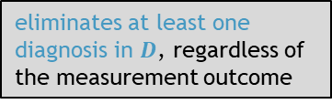









Sequential Diagnosis [de Kleer, Williams, 1987]
new measurement: $\{out\left(A_{2}\right)=0\}$
new situation 2
new measurement: $\{out\left(A_{2}\right)=1\}$
Initial situation
New situation 1
Initial situation
diagnosis probabilities often derivable from meta information (e.g., known component fault rates)
Example (cont‘d):
Which diagnosis among $D=\{D_{1},D_{2},D_{3}\}$ pinpoints the actually faulty components?
Collect further information to rule out spurious diagnoses → make measurements
E.g.: Measurement point (MP) $out\left(A_{2}\right)$ is informative wrt. $D$
if outcome is 0, then $D_{3}$ is no longer a diagnosis
if outcome is 1, then $D_{1},D_{2}$ are no longer diagnoses
Continue this process until a single (highly probable) diagnosis remains
1
$$C_{1}$$
heuristics are used since optimal MP selection is NP-hard
Always select best informative MP
→ "best" is defined based on some MP selection heuristic (e.g., information gain)
0
$$D_{1}$$
1
1
$$D_{3}$$
$$D_{3}$$
Basis for MP selection = computed set of diagnoses $D$ + diagnosis probabilities
0
?
1
?
new diagnosis
$$C_{2}$$
$$D_{2}$$
Diagnoses + probabilities allow to
estimate probability of different measurement outcomes, and
compute (rate of) eliminated diagnoses for different measurement outcomes
→ common heuristics evaluate MPs based on exactly these two factors
$$C_{2}$$
$$D_{4}$$
$$C_{2}$$
$$C_{2}$$
0
eliminates at least one diagnosis in $D$, regardless of the measurement outcome
Notes:
with $\left\langle p\left(D_{1}\right),p\left(D_{2}\right),p\left(D_{3}\right)\right\rangle =\left\langle 0.93, 0.05, 0.02\right\rangle$
$$\left\{out\left(A_{2}\right)\right\}$$

Slide 6
Model-based Diagnosis – Objectives
Model-based
Diagnosis
our research considers
our research focus
Fault Detection
Fault Localization
Fault Repair
requires
entails
Is there a fault?
Where is the fault?
(Which components are faulty?)
How to fix the fault?
Notes:
historical motivation for MBD:
overcome limitations of rule-based "expert systems" which are
based on experiential ("shallow") knowledge
implicit (context + system structure "hidden" in rules)
→ low flexibility, narrow application context, conditions for rule reuse often unclear
dependent on the amount of experience already gained (cf. "cold start problem")
→ often low fault coverage (e.g., new car), especially for multiple/independent faults
not appropriate for critical systems (e.g., airplanes, nuclear power plants)
→ collecting empirical associations for failures in such systems not possible/ethical
use first-principles ("deep") knowledge of a system
(e.g., understanding + representation of workings + interrelations of system components)

Slide 7
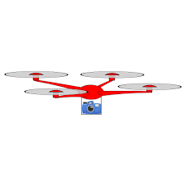


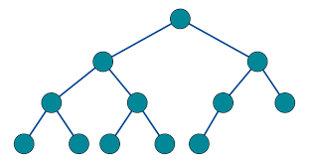

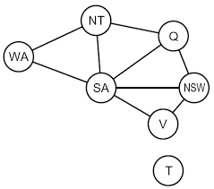
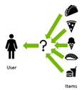



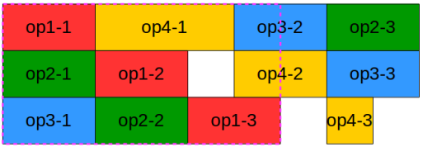




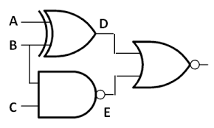


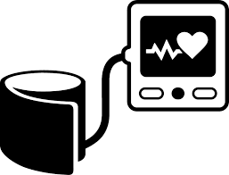
Model-based Diagnosis – Applications
formal
systems
vehicles
Model-based
Diagnosis
principled, domain-independent, generally applicable
physical
systems
....
cyberphysical
systems
(any system amenable
to formal description
in decidable, monotonic language for which
sound + complete
reasoners exist)
Notes:
https://www.google.com/imgres?imgurl=https%3A%2F%2Fstatic.vecteezy.com%2Fsystem%2Fresources%2Fpreviews%2F006%2F605%2F293%2Fnon_2x%2Fturbine-icon-symbol-flat-illustration-for-graphic-and-web-design-free-vector.jpg&imgrefurl=https%3A%2F%2Fwww.vecteezy.com%2Fvector-art%2F6605293-turbine-icon-symbol-flat-vector-illustration-for-graphic-and-web-design&tbnid=DI7Rbg6Z5ng0AM&vet=12ahUKEwjOxaK3ivX6AhULyKQKHbLIAbgQMygAegUIARDJAQ..i&docid=D7vEXFmkYrTx9M&w=980&h=980&q=turbine%20icon&hl=de&ved=2ahUKEwjOxaK3ivX6AhULyKQKHbLIAbgQMygAegUIARDJAQ
https://www.google.com/imgres?imgurl=https%3A%2F%2Fvectorportal.com%2Fstorage%2Fprinter-vector.jpg&imgrefurl=https%3A%2F%2Fvectorportal.com%2Fvector%2Fgray-printer-icon.ai%2F16079&tbnid=4FqsRzShFB1toM&vet=12ahUKEwjjqsbxifX6AhUEtqQKHRQHAiEQMygWegUIARDuAQ..i&docid=5nluQe6ELZ5KIM&w=660&h=660&q=printer%20icon&hl=de&ved=2ahUKEwjjqsbxifX6AhUEtqQKHRQHAiEQMygWegUIARDuAQ
https://www.google.com/imgres?imgurl=x-raw-image%3A%2F%2F%2F1ee77df587181153ee4a6b1ede9c54f6bad5e5a535a51858d4c24238706c5ff5&imgrefurl=https%3A%2F%2Finst.eecs.berkeley.edu%2F~cs188%2Ffa18%2Fassets%2Fslides%2Flec4%2FFA18_cs188_lecture4_CSPs_6pp.pdf&tbnid=UxEYh_V95x5Y9M&vet=12ahUKEwjD8da8ifX6AhWqxwIHHSzNDFMQMygoegUIARCHAg..i&docid=aDS3-l0ZlFIXhM&w=433&h=381&q=constraint%20satisfaction%20problem%20icon&hl=de&ved=2ahUKEwjD8da8ifX6AhWqxwIHHSzNDFMQMygoegUIARCHAg
https://www.google.com/imgres?imgurl=https%3A%2F%2Fcdn-icons-png.flaticon.com%2F512%2F2561%2F2561991.png&imgrefurl=https%3A%2F%2Fwww.flaticon.com%2Ffree-icon%2Fnetwork_2561991&tbnid=RwMPeDlMJa9VmM&vet=12ahUKEwipoKDTiPX6AhUlIMUKHVn0BSgQMygCegUIARDXAQ..i&docid=eyLJ6e_0dRIpLM&w=512&h=512&q=network%20icon&hl=de&ved=2ahUKEwipoKDTiPX6AhUlIMUKHVn0BSgQMygCegUIARDXAQ
https://www.google.com/imgres?imgurl=https%3A%2F%2Fimage.shutterstock.com%2Fimage-vector%2Fprogramming-vector-icon-260nw-622916336.jpg&imgrefurl=https%3A%2F%2Ficons8.com%2Ficons%2Fset%2Fprogramming&tbnid=3O5tZZMqw-TgRM&vet=12ahUKEwjvkbn3h_X6AhUru6QKHS8eCiUQMyhVegUIARClAQ..i&docid=ALGF4QBoPom6sM&w=247&h=280&q=program%20code%20icon&hl=de&ved=2ahUKEwjvkbn3h_X6AhUru6QKHS8eCiUQMyhVegUIARClAQ
https://www.google.com/imgres?imgurl=https%3A%2F%2Fpublicdomainvectors.org%2Fphotos%2Fspreadsheet-document-icon-cleaned-notext.png&imgrefurl=https%3A%2F%2Fpublicdomainvectors.org%2Fen%2Ffree-clipart%2FSpreadsheet-document-symbol%2F82902.html&tbnid=xdGYmARXweqZ9M&vet=12ahUKEwiOzYLchvX6AhWgxwIHHSOyDsAQMygUegUIARCCAQ..i&docid=iA5ycLfnQH4M5M&w=500&h=500&q=spreadsheet%20icon&hl=de&ved=2ahUKEwiOzYLchvX6AhWgxwIHHSOyDsAQMygUegUIARCCAQ
https://www.google.com/imgres?imgurl=https%3A%2F%2Fcdn.iconscout.com%2Ficon%2Ffree%2Fpng-256%2Fprocessor-chip-2689535-2232196.png&imgrefurl=https%3A%2F%2Ficonscout.com%2Ficon%2Fprocessor-chip-2689535&tbnid=0vwwBNXYYiNUAM&vet=12ahUKEwivgOm5hvX6AhUzyAIHHR5gDEsQMygBegQIARBM..i&docid=k1rY_Afbd1E6LM&w=256&h=256&q=processor%20icon&hl=de&ved=2ahUKEwivgOm5hvX6AhUzyAIHHR5gDEsQMygBegQIARBM
https://www.google.com/imgres?imgurl=https%3A%2F%2Fmedia.istockphoto.com%2Fvectors%2Fpower-lines-icon-on-white-background-vector-id1057997114%3Fk%3D20%26m%3D1057997114%26s%3D612x612%26w%3D0%26h%3DkdtGQSDQhAdofXBC1O2Ok5qtDaHfSjPeSVyI7o4qo8M%3D&imgrefurl=https%3A%2F%2Fwww.istockphoto.com%2Fillustrations%2Fpower-grid-icon&tbnid=Y77uocP0eF43tM&vet=12ahUKEwi9iq_HhfX6AhWWD-wKHQ_7BE0QMygBegUIARDPAQ..i&docid=kxvk5t3lpSEOOM&w=612&h=612&q=power%20grid%20icon&hl=de&ved=2ahUKEwi9iq_HhfX6AhWWD-wKHQ_7BE0QMygBegUIARDPAQ
https://www.google.com/imgres?imgurl=https%3A%2F%2Fcdn-icons-png.flaticon.com%2F512%2F2274%2F2274770.png&imgrefurl=https%3A%2F%2Fwww.flaticon.com%2Ffree-icon%2Ftraffic-control_2274770&tbnid=XybIplxeOJXySM&vet=12ahUKEwiCmtz1hPX6AhVKNuwKHaGWBhYQMygAegUIARC0AQ..i&docid=O3B8oBihx1mZKM&w=512&h=512&q=traffic%20control%20system%20icon&hl=de&ved=2ahUKEwiCmtz1hPX6AhVKNuwKHaGWBhYQMygAegUIARC0AQ
https://www.google.com/imgres?imgurl=https%3A%2F%2Fupload.wikimedia.org%2Fwikipedia%2Fcommons%2F7%2F7f%2FRobot.svg&imgrefurl=https%3A%2F%2Fcommons.wikimedia.org%2Fwiki%2FFile%3ARobot.svg&tbnid=dbBTTrF9mcgPSM&vet=12ahUKEwje5cDihPX6AhUBdRoKHaw3BIAQMygHegQIARBg..i&docid=qJ5a_6n1SxgRjM&w=800&h=800&q=robot%20icon&hl=de&ved=2ahUKEwje5cDihPX6AhUBdRoKHaw3BIAQMygHegQIARBg
https://www.google.com/imgres?imgurl=https%3A%2F%2Fcdn-icons-png.flaticon.com%2F512%2F5984%2F5984464.png&imgrefurl=https%3A%2F%2Fwww.flaticon.com%2Ffree-icon%2Fconfiguration_5984464&tbnid=08bHQ8Rhf_KuFM&vet=12ahUKEwiijPyihPX6AhUE_hoKHUgHCm8QMygBegUIARDKAQ..i&docid=Un8LhqABQa-5VM&w=512&h=512&q=configurator%20icon&hl=de&ved=2ahUKEwiijPyihPX6AhUE_hoKHUgHCm8QMygBegUIARDKAQ
https://www.google.com/imgres?imgurl=https%3A%2F%2Fupload.wikimedia.org%2Fwikipedia%2Fcommons%2F9%2F93%2FLogic_circuit_example.png&imgrefurl=https%3A%2F%2Fcommons.wikimedia.org%2Fwiki%2FFile%3ALogic_circuit_example.png&tbnid=LnH9KJ47j07DLM&vet=12ahUKEwj-67-tg_X6AhVOnRoKHbgQBHMQMygBegQIARBI..i&docid=ah7NxsoEIN5MAM&w=385&h=231&q=circuit%20logical&hl=de&ved=2ahUKEwj-67-tg_X6AhVOnRoKHbgQBHMQMygBegQIARBI
https://www.google.com/imgres?imgurl=https%3A%2F%2Ffreesvg.org%2Fimg%2Fdrone.png&imgrefurl=https%3A%2F%2Ffreesvg.org%2Fdrone&tbnid=zxzgfsvM3pY7OM&vet=12ahUKEwiixo6JgPX6AhUcwAIHHWzVBFwQMygqegUIARDyAQ..i&docid=Kv_gbB_Et0djEM&w=600&h=600&q=drone&hl=de&ved=2ahUKEwiixo6JgPX6AhUcwAIHHWzVBFwQMygqegUIARDyAQ
https://www.google.com/imgres?imgurl=https%3A%2F%2Fcdn.iconscout.com%2Ficon%2Ffree%2Fpng-256%2Faeroplane-airplane-plane-air-transportation-vehicle-pessanger-people-emoj-symbol-30708.png&imgrefurl=https%3A%2F%2Ficonscout.com%2Ficon%2Faeroplane-airplane-plane-air-transportation-vehicle-pessanger-people-emoj-symbol&tbnid=J3G73YT6uAyhWM&vet=12ahUKEwjyhauvgPX6AhXEyKQKHW_QD1QQMygRegUIARCMAg..i&docid=Qh31LOWhxZuWCM&w=256&h=256&q=aircraft%20symbol&hl=de&ved=2ahUKEwjyhauvgPX6AhXEyKQKHW_QD1QQMygRegUIARCMAg
https://www.google.com/imgres?imgurl=https%3A%2F%2Fcdn-icons-png.flaticon.com%2F512%2F744%2F744465.png&imgrefurl=https%3A%2F%2Fwww.flaticon.com%2Ffree-icon%2Fcar_744465&tbnid=RWYSLuwfEqeo8M&vet=12ahUKEwiokarqgPX6AhUPXRoKHV0GAEIQMygMegUIARDjAQ..i&docid=mb6wBtLXN9TNuM&w=512&h=512&q=car%20icon&hl=de&ved=2ahUKEwiokarqgPX6AhUPXRoKHV0GAEIQMygMegUIARDjAQ
https://www.google.com/imgres?imgurl=https%3A%2F%2Fupload.wikimedia.org%2Fwikipedia%2Fcommons%2Fd%2Fd9%2FComplete_binary2.svg&imgrefurl=https%3A%2F%2Fcommons.wikimedia.org%2Fwiki%2FFile%3AComplete_binary2.svg&tbnid=PE8uwGhB_IOHTM&vet=12ahUKEwizpIi9gfX6AhUC-hoKHe2oAxcQMygIegQIARBW..i&docid=xyOXQyn1HExk2M&w=900&h=470&q=ontology%20symbol&hl=de&ved=2ahUKEwizpIi9gfX6AhUC-hoKHe2oAxcQMygIegQIARBW
https://www.google.com/imgres?imgurl=https%3A%2F%2Fdeveloper-blogs.nvidia.com%2Fwp-content%2Fuploads%2F2021%2F04%2FWhats-recommendation-sys_pic1.png&imgrefurl=https%3A%2F%2Fdeveloper.nvidia.com%2Fblog%2Fhow-to-build-a-winning-recommendation-system-part-1%2F&tbnid=FxytPegaPmRtXM&vet=12ahUKEwiR_aqSgvX6AhUGhxoKHZL3BW4QMygEegUIARDAAQ..i&docid=E9wz9W7OdWQ6gM&w=432&h=430&q=recommender%20system&hl=de&ved=2ahUKEwiR_aqSgvX6AhUGhxoKHZL3BW4QMygEegUIARDAAQ

Slide 8


Model-based Diagnosis – Specific vs General Methods
our application focus
ontologies/KBs
formal
systems
vehicles
spreadsheets
model-based
diagnosis
Model-based Diagnosis
Method
our research focus
scheduling
problems
specific
general
physical
systems
....
cyberphysical
systems
(any system amenable
to formal description
in decidable, monotonic language for which
sound + complete
reasoners exist)
Notes:
https://www.google.com/imgres?imgurl=https%3A%2F%2Fstatic.vecteezy.com%2Fsystem%2Fresources%2Fpreviews%2F006%2F605%2F293%2Fnon_2x%2Fturbine-icon-symbol-flat-illustration-for-graphic-and-web-design-free-vector.jpg&imgrefurl=https%3A%2F%2Fwww.vecteezy.com%2Fvector-art%2F6605293-turbine-icon-symbol-flat-vector-illustration-for-graphic-and-web-design&tbnid=DI7Rbg6Z5ng0AM&vet=12ahUKEwjOxaK3ivX6AhULyKQKHbLIAbgQMygAegUIARDJAQ..i&docid=D7vEXFmkYrTx9M&w=980&h=980&q=turbine%20icon&hl=de&ved=2ahUKEwjOxaK3ivX6AhULyKQKHbLIAbgQMygAegUIARDJAQ
https://www.google.com/imgres?imgurl=https%3A%2F%2Fvectorportal.com%2Fstorage%2Fprinter-vector.jpg&imgrefurl=https%3A%2F%2Fvectorportal.com%2Fvector%2Fgray-printer-icon.ai%2F16079&tbnid=4FqsRzShFB1toM&vet=12ahUKEwjjqsbxifX6AhUEtqQKHRQHAiEQMygWegUIARDuAQ..i&docid=5nluQe6ELZ5KIM&w=660&h=660&q=printer%20icon&hl=de&ved=2ahUKEwjjqsbxifX6AhUEtqQKHRQHAiEQMygWegUIARDuAQ
https://www.google.com/imgres?imgurl=x-raw-image%3A%2F%2F%2F1ee77df587181153ee4a6b1ede9c54f6bad5e5a535a51858d4c24238706c5ff5&imgrefurl=https%3A%2F%2Finst.eecs.berkeley.edu%2F~cs188%2Ffa18%2Fassets%2Fslides%2Flec4%2FFA18_cs188_lecture4_CSPs_6pp.pdf&tbnid=UxEYh_V95x5Y9M&vet=12ahUKEwjD8da8ifX6AhWqxwIHHSzNDFMQMygoegUIARCHAg..i&docid=aDS3-l0ZlFIXhM&w=433&h=381&q=constraint%20satisfaction%20problem%20icon&hl=de&ved=2ahUKEwjD8da8ifX6AhWqxwIHHSzNDFMQMygoegUIARCHAg
https://www.google.com/imgres?imgurl=https%3A%2F%2Fcdn-icons-png.flaticon.com%2F512%2F2561%2F2561991.png&imgrefurl=https%3A%2F%2Fwww.flaticon.com%2Ffree-icon%2Fnetwork_2561991&tbnid=RwMPeDlMJa9VmM&vet=12ahUKEwipoKDTiPX6AhUlIMUKHVn0BSgQMygCegUIARDXAQ..i&docid=eyLJ6e_0dRIpLM&w=512&h=512&q=network%20icon&hl=de&ved=2ahUKEwipoKDTiPX6AhUlIMUKHVn0BSgQMygCegUIARDXAQ
https://www.google.com/imgres?imgurl=https%3A%2F%2Fimage.shutterstock.com%2Fimage-vector%2Fprogramming-vector-icon-260nw-622916336.jpg&imgrefurl=https%3A%2F%2Ficons8.com%2Ficons%2Fset%2Fprogramming&tbnid=3O5tZZMqw-TgRM&vet=12ahUKEwjvkbn3h_X6AhUru6QKHS8eCiUQMyhVegUIARClAQ..i&docid=ALGF4QBoPom6sM&w=247&h=280&q=program%20code%20icon&hl=de&ved=2ahUKEwjvkbn3h_X6AhUru6QKHS8eCiUQMyhVegUIARClAQ
https://www.google.com/imgres?imgurl=https%3A%2F%2Fpublicdomainvectors.org%2Fphotos%2Fspreadsheet-document-icon-cleaned-notext.png&imgrefurl=https%3A%2F%2Fpublicdomainvectors.org%2Fen%2Ffree-clipart%2FSpreadsheet-document-symbol%2F82902.html&tbnid=xdGYmARXweqZ9M&vet=12ahUKEwiOzYLchvX6AhWgxwIHHSOyDsAQMygUegUIARCCAQ..i&docid=iA5ycLfnQH4M5M&w=500&h=500&q=spreadsheet%20icon&hl=de&ved=2ahUKEwiOzYLchvX6AhWgxwIHHSOyDsAQMygUegUIARCCAQ
https://www.google.com/imgres?imgurl=https%3A%2F%2Fcdn.iconscout.com%2Ficon%2Ffree%2Fpng-256%2Fprocessor-chip-2689535-2232196.png&imgrefurl=https%3A%2F%2Ficonscout.com%2Ficon%2Fprocessor-chip-2689535&tbnid=0vwwBNXYYiNUAM&vet=12ahUKEwivgOm5hvX6AhUzyAIHHR5gDEsQMygBegQIARBM..i&docid=k1rY_Afbd1E6LM&w=256&h=256&q=processor%20icon&hl=de&ved=2ahUKEwivgOm5hvX6AhUzyAIHHR5gDEsQMygBegQIARBM
https://www.google.com/imgres?imgurl=https%3A%2F%2Fmedia.istockphoto.com%2Fvectors%2Fpower-lines-icon-on-white-background-vector-id1057997114%3Fk%3D20%26m%3D1057997114%26s%3D612x612%26w%3D0%26h%3DkdtGQSDQhAdofXBC1O2Ok5qtDaHfSjPeSVyI7o4qo8M%3D&imgrefurl=https%3A%2F%2Fwww.istockphoto.com%2Fillustrations%2Fpower-grid-icon&tbnid=Y77uocP0eF43tM&vet=12ahUKEwi9iq_HhfX6AhWWD-wKHQ_7BE0QMygBegUIARDPAQ..i&docid=kxvk5t3lpSEOOM&w=612&h=612&q=power%20grid%20icon&hl=de&ved=2ahUKEwi9iq_HhfX6AhWWD-wKHQ_7BE0QMygBegUIARDPAQ
https://www.google.com/imgres?imgurl=https%3A%2F%2Fcdn-icons-png.flaticon.com%2F512%2F2274%2F2274770.png&imgrefurl=https%3A%2F%2Fwww.flaticon.com%2Ffree-icon%2Ftraffic-control_2274770&tbnid=XybIplxeOJXySM&vet=12ahUKEwiCmtz1hPX6AhVKNuwKHaGWBhYQMygAegUIARC0AQ..i&docid=O3B8oBihx1mZKM&w=512&h=512&q=traffic%20control%20system%20icon&hl=de&ved=2ahUKEwiCmtz1hPX6AhVKNuwKHaGWBhYQMygAegUIARC0AQ
https://www.google.com/imgres?imgurl=https%3A%2F%2Fupload.wikimedia.org%2Fwikipedia%2Fcommons%2F7%2F7f%2FRobot.svg&imgrefurl=https%3A%2F%2Fcommons.wikimedia.org%2Fwiki%2FFile%3ARobot.svg&tbnid=dbBTTrF9mcgPSM&vet=12ahUKEwje5cDihPX6AhUBdRoKHaw3BIAQMygHegQIARBg..i&docid=qJ5a_6n1SxgRjM&w=800&h=800&q=robot%20icon&hl=de&ved=2ahUKEwje5cDihPX6AhUBdRoKHaw3BIAQMygHegQIARBg
https://www.google.com/imgres?imgurl=https%3A%2F%2Fcdn-icons-png.flaticon.com%2F512%2F5984%2F5984464.png&imgrefurl=https%3A%2F%2Fwww.flaticon.com%2Ffree-icon%2Fconfiguration_5984464&tbnid=08bHQ8Rhf_KuFM&vet=12ahUKEwiijPyihPX6AhUE_hoKHUgHCm8QMygBegUIARDKAQ..i&docid=Un8LhqABQa-5VM&w=512&h=512&q=configurator%20icon&hl=de&ved=2ahUKEwiijPyihPX6AhUE_hoKHUgHCm8QMygBegUIARDKAQ
https://www.google.com/imgres?imgurl=https%3A%2F%2Fupload.wikimedia.org%2Fwikipedia%2Fcommons%2F9%2F93%2FLogic_circuit_example.png&imgrefurl=https%3A%2F%2Fcommons.wikimedia.org%2Fwiki%2FFile%3ALogic_circuit_example.png&tbnid=LnH9KJ47j07DLM&vet=12ahUKEwj-67-tg_X6AhVOnRoKHbgQBHMQMygBegQIARBI..i&docid=ah7NxsoEIN5MAM&w=385&h=231&q=circuit%20logical&hl=de&ved=2ahUKEwj-67-tg_X6AhVOnRoKHbgQBHMQMygBegQIARBI
https://www.google.com/imgres?imgurl=https%3A%2F%2Ffreesvg.org%2Fimg%2Fdrone.png&imgrefurl=https%3A%2F%2Ffreesvg.org%2Fdrone&tbnid=zxzgfsvM3pY7OM&vet=12ahUKEwiixo6JgPX6AhUcwAIHHWzVBFwQMygqegUIARDyAQ..i&docid=Kv_gbB_Et0djEM&w=600&h=600&q=drone&hl=de&ved=2ahUKEwiixo6JgPX6AhUcwAIHHWzVBFwQMygqegUIARDyAQ
https://www.google.com/imgres?imgurl=https%3A%2F%2Fcdn.iconscout.com%2Ficon%2Ffree%2Fpng-256%2Faeroplane-airplane-plane-air-transportation-vehicle-pessanger-people-emoj-symbol-30708.png&imgrefurl=https%3A%2F%2Ficonscout.com%2Ficon%2Faeroplane-airplane-plane-air-transportation-vehicle-pessanger-people-emoj-symbol&tbnid=J3G73YT6uAyhWM&vet=12ahUKEwjyhauvgPX6AhXEyKQKHW_QD1QQMygRegUIARCMAg..i&docid=Qh31LOWhxZuWCM&w=256&h=256&q=aircraft%20symbol&hl=de&ved=2ahUKEwjyhauvgPX6AhXEyKQKHW_QD1QQMygRegUIARCMAg
https://www.google.com/imgres?imgurl=https%3A%2F%2Fcdn-icons-png.flaticon.com%2F512%2F744%2F744465.png&imgrefurl=https%3A%2F%2Fwww.flaticon.com%2Ffree-icon%2Fcar_744465&tbnid=RWYSLuwfEqeo8M&vet=12ahUKEwiokarqgPX6AhUPXRoKHV0GAEIQMygMegUIARDjAQ..i&docid=mb6wBtLXN9TNuM&w=512&h=512&q=car%20icon&hl=de&ved=2ahUKEwiokarqgPX6AhUPXRoKHV0GAEIQMygMegUIARDjAQ
https://www.google.com/imgres?imgurl=https%3A%2F%2Fupload.wikimedia.org%2Fwikipedia%2Fcommons%2Fd%2Fd9%2FComplete_binary2.svg&imgrefurl=https%3A%2F%2Fcommons.wikimedia.org%2Fwiki%2FFile%3AComplete_binary2.svg&tbnid=PE8uwGhB_IOHTM&vet=12ahUKEwizpIi9gfX6AhUC-hoKHe2oAxcQMygIegQIARBW..i&docid=xyOXQyn1HExk2M&w=900&h=470&q=ontology%20symbol&hl=de&ved=2ahUKEwizpIi9gfX6AhUC-hoKHe2oAxcQMygIegQIARBW
https://www.google.com/imgres?imgurl=https%3A%2F%2Fdeveloper-blogs.nvidia.com%2Fwp-content%2Fuploads%2F2021%2F04%2FWhats-recommendation-sys_pic1.png&imgrefurl=https%3A%2F%2Fdeveloper.nvidia.com%2Fblog%2Fhow-to-build-a-winning-recommendation-system-part-1%2F&tbnid=FxytPegaPmRtXM&vet=12ahUKEwiR_aqSgvX6AhUGhxoKHZL3BW4QMygEegUIARDAAQ..i&docid=E9wz9W7OdWQ6gM&w=432&h=430&q=recommender%20system&hl=de&ved=2ahUKEwiR_aqSgvX6AhUGhxoKHZL3BW4QMygEegUIARDAAQ

Slide 9
Model-based Diagnosis – Related Areas
automated reasoning
(deductive, abductive)
algorithms + data structures
knowledge representation
intelligent search
heuristic problem solving
Model-based Diagnosis
complexity theory
stochastics, statistics
machine learning, active learning
(system/user)
modeling
reasoning + decision making under uncertainty
combinatorics
set theory

Slide 10
Model-based Diagnosis – Related Areas
problem: find (cost-)optimal set from collection X of subsets of a universe
approach: use best-first hitting set computation over the dual collection of X
(dual collection of X includes all subsets of universe whose complement is not in X)
e.g., minimal unsatisfiable subsets, minimal correction subsets, preferred explanations, prime implicants
example: conflicts are dual to diagnoses
(many other applications)
hitting set / set cover problem
(NP-complete problem solving)
minimal subset subject to monotone predicate (MSMP) problem [Marques-Silva et al, 2013]
duality-based problem solving + optimization [Slaney, 14]
Semantic Web,
ontology quality assurance
Model-based Diagnosis
machine learning
(e.g., explainable AI)
(Max)SAT,
(Max)CSP
sequential decision making / reasoning under uncertainty
(re)scheduling,
(re)configuration
recommender systems
software engineering
robotics

Slide 11






Generic (Sequential) Diagnosis System
E.g.:
most informative measurement (circuit debugging), most informative question about intended KB
(KB debugging)
Functionality
Goals
maximize
performance!
(time, quality
of output)
E.g.:
electrical engineer (circuit debugging), domain expert
(KB debugging)
Input:
SD, COMPS, OBS, MEAS
maximize
performance!
(time, memory,
quality of output)
(Sequential) Diagnosis System
Query Selection
Query Generation
Queries
Best Query
optimize system model!
(accuracy, efficiency)
Query+Answer
Answer
DPI
Oracle
New
Measurement
expensive!
expensive!
Diagnoses
minimize effort!
(few + inexpen-
sive queries)
Diagnosis Engine
Input
param tuning,
study of heuristics,
optimal use of
fault information
Logical Reasoner
Meta Information
minimize!
Output:
Diagnosis $D^{∗}$
maximize
performance!
(time, memory,
quality of output)
E.g.:
actually faulty gates (circuit debugging), actually faulty axioms
(KB debugging)
E.g.:
fault information (e.g., probabilities),
algorithm parameters (e.g., stop criteria),
heuristics (e.g., for query selection)

Slide 12
Research Overview

Slide 13
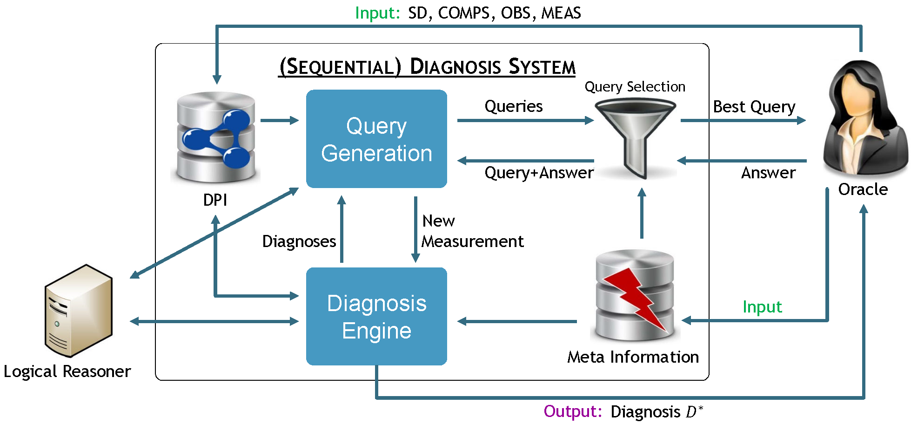
Our Research
Overview by system aspect considered
1
Patrick Rodler. How should I compute my candidates? A taxonomy and classification of diagnosis computation algorithms. In: Int’l Workshop on Principles of Diagnosis (DX-22). 2022
Patrick Rodler. Memory-limited model-based diagnosis. Artificial Intelligence 305: 103681. 2022
Patrick Rodler. DynamicHS: Streamlining Reiter's hitting-set tree for sequential diagnosis. Information Sciences. 2022
Patrick Rodler. Random vs. Best-First: Impact of Sampling Strategies on Decision Making in Model-Based Diagnosis. In: AAAI Conference on Artificial Intelligence (AAAI-22). 2022
Patrick Rodler, Erich Teppan, Dietmar Jannach. Randomized Problem-Relaxation Solving for Over-Constrained Schedules. In: Int’l Conference on Principles of Knowledge Representation and Reasoning (KR-21). 2021
Patrick Rodler. Linear-space best-first diagnosis search. In: Int’l Symposium on Combinatorial Search (SoCS-21). 2021
Patrick Rodler. Reuse, Reduce and Recycle: Optimizing Reiter's HS-tree for sequential diagnosis. In: European Conference on Artificial Intelligence (ECAI-20). 2020

Slide 14
Our Research
Overview by system aspect considered
2
Patrick Rodler. Too Good to Throw Away: A Powerful Reuse Strategy for Reiter's Hitting Set Tree. In: Int’l Symposium on Combinatorial Search (SoCS-20). 2020
Patrick Rodler. Sound, complete, linear-space, best-first diagnosis search. In: Int’l Workshop on Principles of Diagnosis (DX-20). 2020
Patrick Rodler, Erich Teppan. The scheduling job-set optimization problem: a model-based diagnosis approach. In: Int’l Workshop on Principles of Diagnosis (DX-20). 2020
Patrick Rodler, Fatima Elichanova. Do we really sample right in model-based diagnosis? In: Int’l Workshop on Principles of Diagnosis (DX-20). 2020
Patrick Rodler. DynamicHS: Optimizing Reiter's HS-Tree for Sequential Diagnosis. In: Int’l Workshop on Principles of Diagnosis (DX-20). 2020
Patrick Rodler. Reuse, Reduce and Recycle: Adapting Reiter’s HS-Tree to Sequential Diagnosis. In: Int’l Workshop on Principles of Diagnosis (DX-19). 2019
Patrick Rodler. Towards Optimizing Reiter's HS-Tree for Sequential Diagnosis. Tech. Report, University of Klagenfurt (ArXiv:1907.12130). 2019

Slide 15
Our Research
Overview by system aspect considered
3
Patrick Rodler. Reducing Sequential Diagnosis Costs by Modifying Reiter’s Hitting Set Tree. In: Int’l Workshop on Principles of Diagnosis (DX-18). 2018
Patrick Rodler, Manuel Herold. StaticHS: A Variant of Reiter's Hitting Set Tree for Efficient Sequential Diagnosis. In: Int’l Symposium on Combinatorial Search (SoCS-18). 2018
Patrick Rodler. Interactive Debugging of Knowledge Bases. Ph.D. Thesis (Informatics), University of Klagenfurt (ArXiv:1605.05950). 2015

Slide 16
Our Research
Overview by system aspect considered
1
Patrick Rodler. Sequential model-based diagnosis by systematic search. Artificial Intelligence (under revision). 2022
Patrick Rodler. One step at a time: An efficient approach to query-based ontology debugging. Knowledge-Based Systems 251: 108987. 2022
Patrick Rodler. On Expert Behaviors and Question Types for Efficient Query-Based Ontology Fault Localization. Tech. Report, University of Klagenfurt (ArXiv:2001.05952). 2020
Patrick Rodler, Michael Eichholzer. On the usefulness of different expert question types for fault localization in ontologies. In: Int’l Conference on Industrial, Engineering and Other Applications of Applied Intelligent Systems (IEA/AIE-19). 2019
Patrick Rodler, Michael Eichholzer. How You Ask Matters: A Simple Expert Questioning Approach for Efficient Ontology Fault Localization. In: Joint Ontology Workshops (JOWO-19). 2019
Patrick Rodler, Michael Eichholzer. On the Usefulness of Different Expert Question Types for Fault Localization in Ontologies. In: Int’l Workshop on Principles of Diagnosis (DX-19). 2019

Slide 17
Our Research
Overview by system aspect considered
2
Patrick Rodler, Michael Eichholzer. A new expert questioning approach to more efficient fault localization in ontologies. Tech. Report, University of Klagenfurt (ArXiv:1904.00317). 2019
Patrick Rodler, Wolfgang Schmid, Konstantin Schekotihin. Inexpensive Cost-Optimized Measurement Proposal for Sequential Model-Based Diagnosis. In: Int’l Workshop on Principles of Diagnosis (DX-17). 2017
Patrick Rodler. On Active Learning Strategies for Sequential Diagnosis. In: Int’l Workshop on Principles of Diagnosis (DX-17). 2017
Patrick Rodler, Wolfgang Schmid, Konstantin Schekotihin. A Generally Applicable, Highly Scalable Measurement Computation and Optimization Approach to Sequential Model-Based Diagnosis. Tech. Report, University of Klagenfurt (ArXiv:1711.05508). 2017
Patrick Rodler. Towards Better Response Times and Higher-Quality Queries in Interactive Knowledge Base Debugging. Tech. Report, University of Klagenfurt (ArXiv:1609.02584). 2016

Slide 18
Our Research
Overview by system aspect considered
1
Patrick Rodler. Sequential model-based diagnosis by systematic search. Artificial Intelligence (under revision). 2022
Patrick Rodler. One step at a time: An efficient approach to query-based ontology debugging. Knowledge-Based Systems 251: 108987. 2022
Patrick Rodler. Random vs. Best-First: Impact of Sampling Strategies on Decision Making in Model-Based Diagnosis. In: AAAI Conference on Artificial Intelligence (AAAI-22). 2022
Patrick Rodler, Fatima Elichanova. Do we really sample right in model-based diagnosis? In: Int’l Workshop on Principles of Diagnosis (DX-20). 2020
Patrick Rodler, Michael Eichholzer. A new expert questioning approach to more efficient fault localization in ontologies. Tech. Report, University of Klagenfurt (ArXiv:1904.00317). 2019
Patrick Rodler. Comparing the Performance of Traditional and Novel Heuristics for Sequential Diagnosis. In: Int’l Workshop on Principles of Diagnosis (DX-18). 2018
Patrick Rodler, Wolfgang Schmid. On the Impact and Proper Use of Heuristics in Test-Driven Ontology Debugging. In: Int’l Joint Conference on Rules and Reasoning (RuleML+RR-18). 2018

Slide 19
Our Research
Overview by system aspect considered
2
Patrick Rodler, Wolfgang Schmid, Konstantin Schekotihin. Inexpensive Cost-Optimized Measurement Proposal for Sequential Model-Based Diagnosis. In: Int’l Workshop on Principles of Diagnosis (DX-17). 2017
Patrick Rodler. On Active Learning Strategies for Sequential Diagnosis. In: Int’l Workshop on Principles of Diagnosis (DX-17). 2017
Patrick Rodler, Wolfgang Schmid, Konstantin Schekotihin. A Generally Applicable, Highly Scalable Measurement Computation and Optimization Approach to Sequential Model-Based Diagnosis. Tech. Report, University of Klagenfurt (ArXiv:1711.05508). 2017
Patrick Rodler. Towards Better Response Times and Higher-Quality Queries in Interactive Knowledge Base Debugging. Tech. Report, University of Klagenfurt (ArXiv:1609.02584). 2016
Patrick Rodler, Kostyantyn Shchekotykhin, Philipp Fleiss, Gerhard Friedrich. RIO: Minimizing User Interaction in Ontology Debugging. In: Web Reasoning and Rule Systems (RR-13). 2013
Kostyantyn Shchekotykhin, Gerhard Friedrich, Philipp Fleiss, Patrick Rodler. Interactive ontology debugging: Two query strategies for efficient fault localization. J. Web Semantics 12: 88-103. 2012

Slide 20
Our Research
Overview by system aspect considered
Patrick Rodler. One step at a time: An efficient approach to query-based ontology debugging. Knowledge-Based Systems 251: 108987. 2022
Patrick Rodler, Dietmar Jannach, Konstantin Schekotihin, Philipp Fleiss. Are query-based ontology debuggers really helping knowledge engineers? Knowledge-Based Systems 179: 92-107. 2019
Patrick Rodler, Michael Eichholzer. A new expert questioning approach to more efficient fault localization in ontologies. Tech. Report, University of Klagenfurt (ArXiv:1904.00317). 2019
Patrick Rodler, Michael Eichholzer. On the usefulness of different expert question types for fault localization in ontologies. In: Int’l Conference on Industrial, Engineering and Other Applications of Applied Intelligent Systems (IEA/AIE-19). 2019
Patrick Rodler, Michael Eichholzer. How You Ask Matters: A Simple Expert Questioning Approach for Efficient Ontology Fault Localization. In: Joint Ontology Workshops (JOWO-19). 2019
Patrick Rodler, Michael Eichholzer. On the Usefulness of Different Expert Question Types for Fault Localization in Ontologies. In: Int’l Workshop on Principles of Diagnosis (DX-19). 2019

Slide 21
Our Research
Overview by system aspect considered
1
Patrick Rodler. One step at a time: An efficient approach to query-based ontology debugging. Knowledge-Based Systems 251: 108987. 2022
Patrick Rodler. Memory-limited model-based diagnosis. Artificial Intelligence 305: 103681. 2022
Patrick Rodler. DynamicHS: Streamlining Reiter's hitting-set tree for sequential diagnosis. Information Sciences. 2022
Patrick Rodler. Sequential model-based diagnosis by systematic search. Artificial Intelligence
(under revision). 2022
Patrick Rodler. How should I compute my candidates? A taxonomy and classification of diagnosis computation algorithms. In: Int’l Workshop on Principles of Diagnosis (DX-22). 2022
Patrick Rodler. Random vs. Best-First: Impact of Sampling Strategies on Decision Making in Model-Based Diagnosis. In: AAAI Conference on Artificial Intelligence (AAAI-22). 2022
Patrick Rodler, Fatima Elichanova. Do we really sample right in model-based diagnosis? In: Int’l Workshop on Principles of Diagnosis (DX-20). 2020
Patrick Rodler, Dietmar Jannach, Konstantin Schekotihin, Philipp Fleiss. Are query-based ontology

Slide 22
Our Research
Overview by system aspect considered
2
debuggers really helping knowledge engineers? Knowledge-Based Systems 179: 92-107. 2019
Patrick Rodler, Michael Eichholzer. On the usefulness of different expert question types for fault localization in ontologies. In: Int’l Conference on Industrial, Engineering and Other Applications of Applied Intelligent Systems (IEA/AIE-19). 2019
Patrick Rodler. Comparing the Performance of Traditional and Novel Heuristics for Sequential Diagnosis. In: Int’l Workshop on Principles of Diagnosis (DX-18). 2018
Patrick Rodler, Wolfgang Schmid. On the Impact and Proper Use of Heuristics in Test-Driven Ontology Debugging. In: Int’l Joint Conference on Rules and Reasoning (RuleML+RR-18). 2018
Patrick Rodler. Interactive Debugging of Knowledge Bases. Ph.D. Thesis (Informatics), University of Klagenfurt (ArXiv:1605.05950). 2015
Patrick Rodler, Kostyantyn Shchekotykhin, Philipp Fleiss, Gerhard Friedrich. RIO: Minimizing User Interaction in Ontology Debugging. In: Web Reasoning and Rule Systems (RR-13). 2013
Kostyantyn Shchekotykhin, Gerhard Friedrich, Philipp Fleiss, Patrick Rodler. Interactive ontology debugging: Two query strategies for efficient fault localization. J. Web Semantics 12: 88-103. 2012

Slide 23
Our Research
Overview by system aspect considered
Patrick Rodler. How should I compute my candidates? A taxonomy and classification of diagnosis computation algorithms. In: Int’l Workshop on Principles of Diagnosis (DX-22). 2022
Patrick Rodler. A formal proof and simple explanation of the QuickXplain algorithm. Artificial Intelligence Review. 2022
Patrick Rodler, Erich Teppan, Dietmar Jannach. Randomized Problem-Relaxation Solving for Over-Constrained Schedules. In: Int’l Conference on Principles of Knowledge Representation and Reasoning (KR-21). 2021
Patrick Rodler, Erich Teppan. The scheduling job-set optimization problem: a model-based diagnosis approach. In: Int’l Workshop on Principles of Diagnosis (DX-20). 2020

Slide 24
Our Research
Overview by system aspect considered
Birgit Hofer, Dietmar Jannach, Iulia Nica, Patrick Rodler, Franz Wotawa. On Modeling Techniques for Spreadsheet Debugging: A Theoretical and Empirical Analysis. (to be submitted to Artificial Intelligence Journal shortly). 2022
Patrick Rodler, Konstantin Schekotihin. Reducing Model-Based Diagnosis to Knowledge Base Debugging. In: Int'l Workshop on Principles of Diagnosis (DX-17). 2017

Slide 25
Our Research
Overview by system aspect considered
Patrick Rodler, Dietmar Jannach, Konstantin Schekotihin, Philipp Fleiss. Are query-based ontology debuggers really helping knowledge engineers? Knowledge-Based Systems 179: 92-107. 2019
Konstantin Schekotihin, Patrick Rodler, Wolfgang Schmid. OntoDebug: Interactive Ontology Debugging Plug-in for Protégé. Foundations of Information and Knowledge Systems – Int’l Symposium (FoIKS-18). 2018
Konstantin Schekotihin, Patrick Rodler, Wolfgang Schmid, Matthew Horridge, Tania Tudorache. Test-driven Ontology Development in Protégé. In: Int’l Conference on Biological Ontology (ICBO-18). 2018
Konstantin Schekotihin, Patrick Rodler, Wolfgang Schmid, Matthew Horridge, Tania Tudorache. A Protégé Plug-In for Test-Driven Ontology Development. In: Int’l Conference on Biological Ontology (ICBO-18). 2018

Slide 26
Research:
Selected works

Slide 27
Memory-Limited Model-Based Diagnosis
Module addressed
Goals
optimize memory complexity
while maintaining good time
performance and other desirable properties
Patrick Rodler, 2022
Artificial Intelligence 305: 103681

Slide 28




Diagnosis Computation Algorithms
# of best diagnoses to be computed
(“best” = e.g., max prob or min card)
DPI = diagnosis problem instance
<system description, components, observations>
This is the problem we
solve in this work!
DPI
diagnosis computation algorithm
opt criterion (max prob or min card), component fault probs, etc.
$$k$$
$k$ diagnoses (if existent)
meta info
existing methods:
desired properties: (i.a.)
soundness
completeness
best-first property
generality / broad applicability
time efficiency
space efficiency
no algorithms that feature all properties
+
+
e.g., STACCATO
[Abreu, van Gemund, 2009]
only diagnoses
+
e.g., HS-Tree [Reiter, 1987]
there are sound + complete + general + space-efficient algorithms
+
all diagnoses
+
+
+
diagnoses enumerated in order as per opt criterion
+
there are sound + time-efficient + space-efficient algorithms
+
independence of used
system description language
theorem prover
(many other combinations)
$$⇒$$
+
WHENEVER sound + complete + best-first + general, THEN exponential space
e.g., Inv-HS-Tree [Schekotihin et al, 2014]
+
+
+

Slide 29
















New Approach: RBF-HS
[Reiter, 1987]
[Korf, 1993]
HS
RBFS
1
systematic generation
of diagnoses as hitting
sets of all conflicts
recursive
best-first
search
$$〈X_{1},A_{2},O_{1}〉$$
globally 2nd best
$$X_{1}$$
$$O_{1}$$
best
globally 2nd best
$$A_{2}$$
locally
2nd best
diagnoses
2
3
4
locally
2nd best
which is better?
best
✔$(D_{1})$
$$〈X_{1},X_{2}〉$$
$$〈X_{1},X_{2}〉$$
locally best
globally
2nd best
$$X_{1}$$
$$X_{2}$$
$$X_{1}$$
$$X_{2}$$
locally best
best
update cost
5
7
locally best
✖$(⊃D_{1})$
6
✖ $(⊃D_{1})$
8
✔ goal found!
✔$(D_{2})$
✔$(D_{3})$
node‘s cost
$$c$$
propagate downwards
propagate downwards
propagate downwards
labels of internal nodes = conflicts
backtrack, but remember cost of best child
challenges (transformation of a path-finding
search into a diagnosis search): e.g.,
defining suitable node labeling/storage strategy
multiple solutions sought
different types of / conditions on cost function
soundness needs to be assured
linear space: no more than one expanded node at each tree level!
edge labels = system components
✖ = non-diagnoses, ✔ = diagnoses
Recursive Best-First Hitting-Set Search
RBF-HS
exponential space!
sound + complete + best-first +
general + linear space

Slide 30
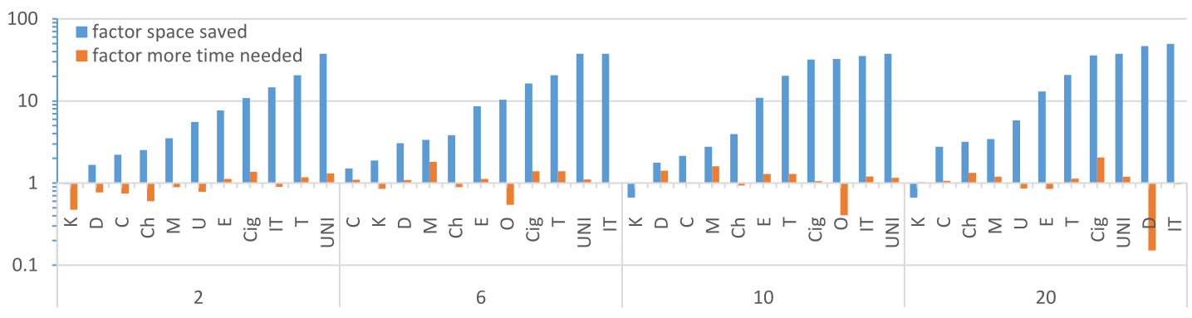
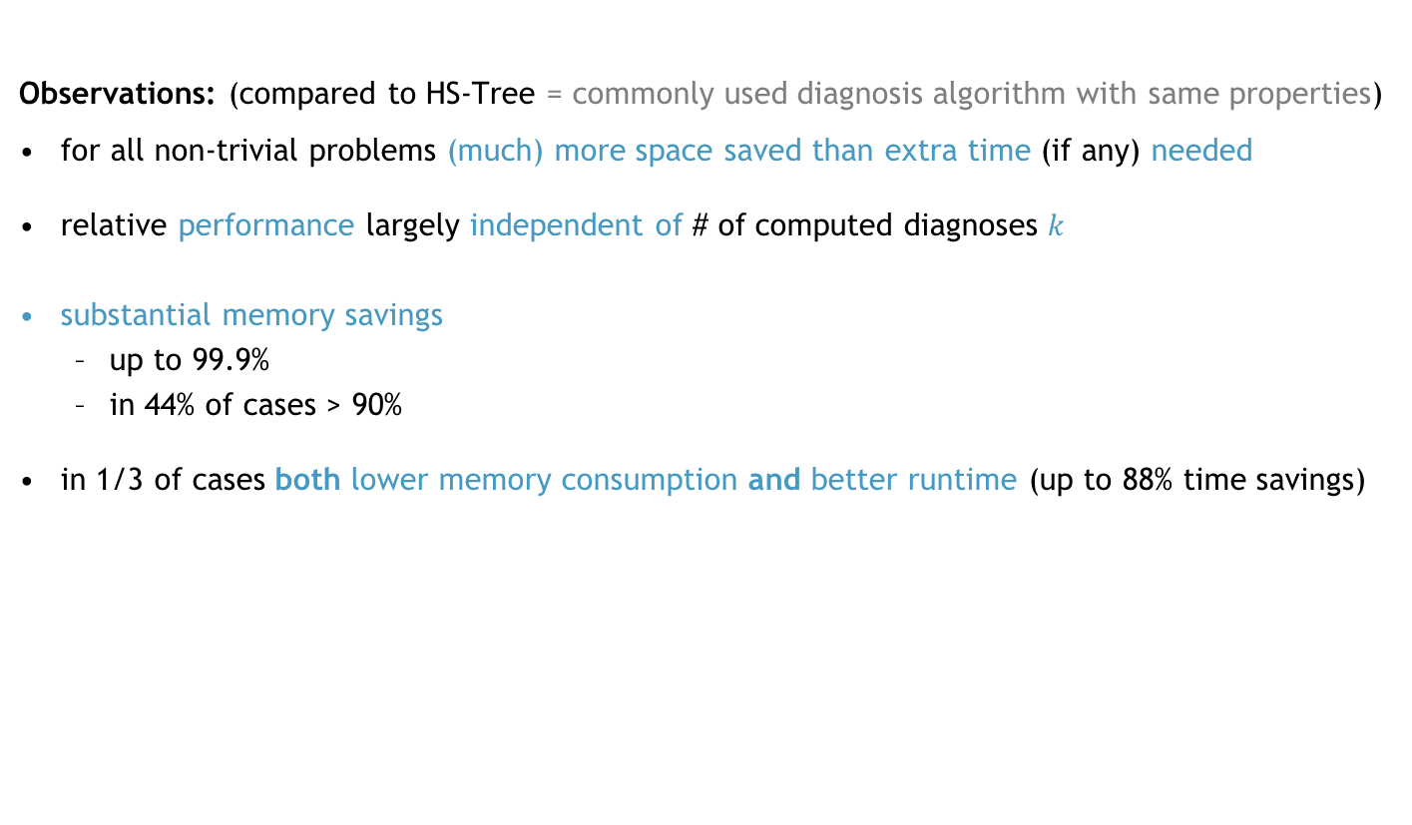
Results: RBF-HS
e.g.: 88% runtime savings, 97% memory savings
diagnosis problems
# computed best (= minimal cardinality) diagnoses $k$
Observations: (compared to HS-Tree = commonly used diagnosis algorithm with same properties)
for all non-trivial problems (much) more space saved than extra time (if any) needed
relative performance largely independent of # of computed diagnoses $k$
substantial memory savings
  up to 99.9%
  in 44% of cases > 90%
in 1/3 of cases both lower memory consumption and better runtime (up to 88% time savings)
importantly: RBF-HS is generally applicable to any hitting-set problem (model-based diagnosis is just a special case)
well-understood phenomenon: [Zhang, Korf,1995]
Notes:
absolute runtimes: min/avg/max = 0.04/24/744 sec
absolute space: min/avg/max = 9/17.5K/1.3M tree nodes

Slide 31
OntoDebug: Interactive Ontology Debugging Plug-in for Protégé
Module addressed
Goals
implement (for ontology debugging) +
optimize performance, usefulness, usability, customizability +
publish as a free tool
Konstantin Schekotihin, Patrick Rodler, Wolfgang Schmid, 2018
Foundations of Information and Knowledge Systems – Int’l Symposium (FoIKS)

Slide 32
Motivation
Many (Semantic Web) applications using ontologies
providing services in often critical fields
e.g. in biomedicine (SNOMED, NCI-T, OBO Foundry)
  ontologies of tremendous size (100.000s of terms + axioms)
  formalizing sensitive medical knowledge (e.g. cancer therapies)
  used in eHealth applications (e.g. patient health records)
Faults in ontologies (e.g. wrong logical consequences) can have severe consequences
e.g. suggesting the wrong medication for a cancer patient
(Manual) ontology debugging is hard given KBs that are
large in size
represented in expressive logics
developed by multiple people or in distributed fashion
(partially) generated by means of automatic systems
→ Tool assistance required!

Slide 33
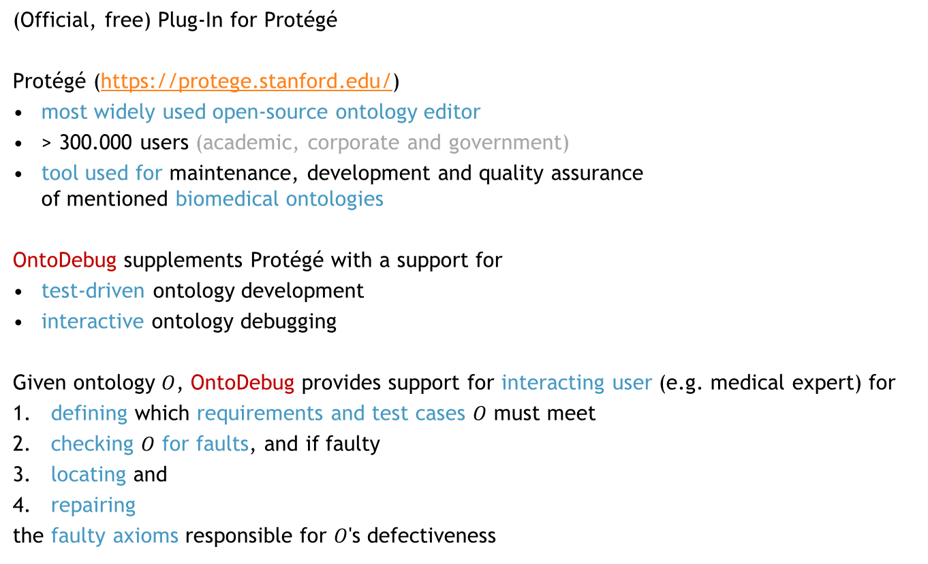
Our Solution: OntoDebug
(Official, free) Plug-In for Protégé
Protégé (https://protege.stanford.edu/)
most widely used open-source ontology editor
> 300.000 users (academic, corporate and government)
tool used for maintenance, development and quality assurance
of mentioned biomedical ontologies
OntoDebug supplements Protégé with a support for
test-driven ontology development
interactive ontology debugging
Given ontology $O$, OntoDebug provides support for interacting user (e.g. medical expert) for
defining which requirements and test cases $O$ must meet
checking $O$ for faults, and if faulty
locating and
repairing
the faulty axioms responsible for $O$'s defectiveness
Notes:
Given
ontology $O$ that
does not satisfy logical requirements $Req$ (e.g. consistency, coherency)
does not imply desired logical consequences $P$ (e.g. “a melanoma must be therapied“)
implies wrong logical consequences $N$ (e.g. “each tumour causes pain“)
correct background knowledge $B$
optional (e.g. to shift )
OntoDebug supports an interacting user (e.g. a medical expert)
to locate and repair the faulty axioms responsible for the ontology‘s defectiveness

Slide 34
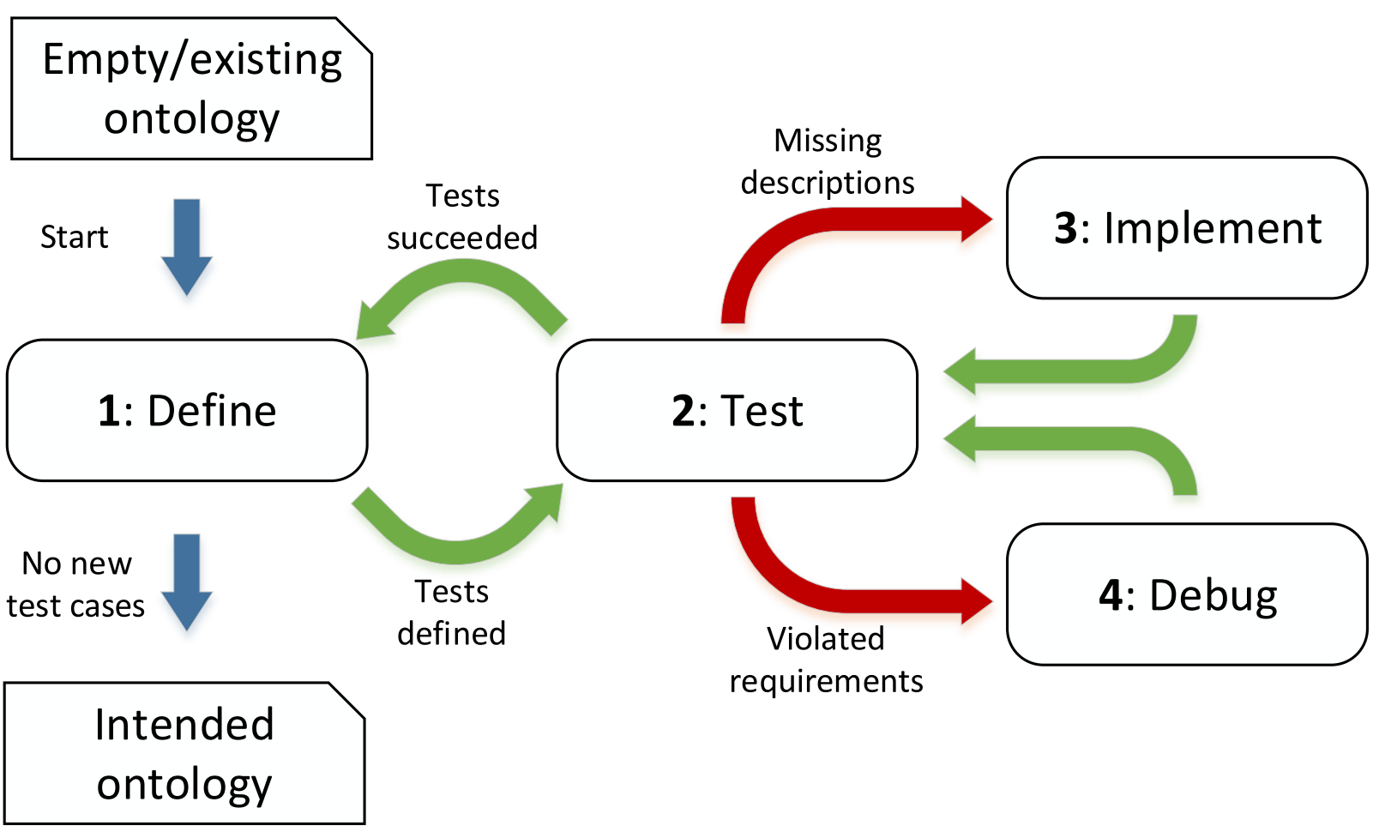

Test-Driven Ontology Development & Debugging
required logical conse-quences
Test Case Verifier
unwanted
logical
conse-
quences
all OK?
Interactive Debugger
query
possible faults
actual fault
faulty axioms
Axioms
answer
rectify/delete axiom
formulate new axioms
show ex-
planation
Ontology
Interactive Repair
analyze axiom
Notes:
Test-driven ontology development
(Interactive) Debugging
Repair

Slide 35
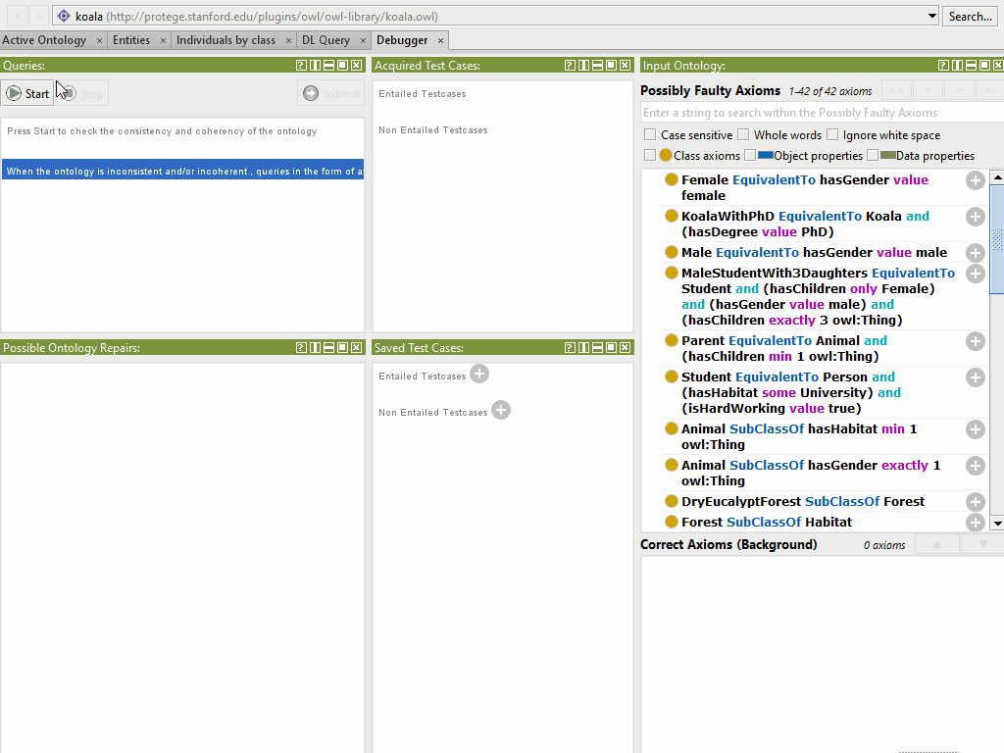
OntoDebug in Action!
specified test cases
(query answers)
query +
answer dialogue
ontology axioms
list of diagnoses (best first)
http://isbi.aau.at/ontodebug

Slide 36
Research:
Summary of Results

Slide 37
Summary of Results
Summary by research paper
Module addressed
Goals
optimize space performance
optimize time performance
[Rodler, 2022, Information Sciences] / [Rodler, 2020, European Conf. on Artificial Intelligence] DynamicHS algorithm
Answers longstanding question posed in seminal paper [Reiter, 1987] (Google Scholar: 4500 citations)
Optimizes HS-Tree (one of the most popular diagnosis algorithms) for sequential diagnosis
Preserves all desirable properties (soundness, completeness, best-firstness, general applicability)
Time efficiency gains of > 50% (avg) and up to 90%
[Rodler, 2022, Artificial Intelligence] RBF-HS algorithm
First diagnosis search that is sound, complete, best-first, generally applicable and linear-space
Compared to most popular algorithm with the same properties:
  Substantial memory savings up to 98%, in almost half of the cases > 90%
  While preserving an overall comparable time performance
  In 33% of cases both memory and time savings
Generally applicable to a wide range of problems (beyond the realm of diagnosis)

Slide 38
Summary of Results
Summary by research paper
Module addressed
Goals
minimize interaction cost
[Rodler, Herold, 2018, Int'l Symp. on Combinatorial Search (SoCS)]
Proposal of
A generalization of sequential diagnosis problem (generalized StatSD)
Efficient algorithm (StaticHS) to solve generalized StatSD
Using StaticHS to solve generalized StatSD (instead of state-of-the-art techniques)
  saves 20% (avg) and up to 65% of user interaction costs in sequential diagnosis
  leads to less or equal user effort in 97% of the cases
[Rodler, Teppan, Jannach, 2021, Int'l Conf. on Principles of Knowledge Representation and Reasoning (KR)]
Randomized optimal diagnosis computation algorithm
For scenarios (e.g., overconstrained scheduling problems) where reasoning is very expensive
Significant time improvements over state-of-the-art solver (better solutions in < half the time)
Diagnosis quality (cardinality) significantly improved by > 25% (avg.) and up to 63%
minimize time + optimize output

Slide 39
Summary of Results
Summary by research paper
Module addressed
Goals
which algorithms exist +
what are their pros and cons + how can they be compared +
what is the best algorithm for my diagnosis problem?
which algorithm to use +
how to use it?
[Rodler, 2022, AAAI Conf. on Artificial Intelligence (AAAI)]
Comprehensive Experimentation:
Study of the impact of "sample" selection (which diagnoses are computed) + size (# of computed diagnoses) + used query selection heuristic on efficiency of diagnostic process
Recommendations on which diagnosis computation method to use in various diagnostic scenarios
[Rodler, 2022, Int'l Workshop on Principles of Diagnosis (DX)]
Taxonomy and survey of diagnosis computation algorithms to help researchers and practitioners
get an impression of the wide and diverse landscape of available methods
easily retrieve pivotal features as well as pros and cons of algorithms
enable an easy and clear comparison of techniques
facilitate the selection of the "right" algorithm to adopt for a particular problem case

Slide 40
Summary of Results
Summary by research paper
Module addressed
Goals
minimize interaction cost
minimize time + optimize output
[Rodler, 2022, Artificial Intelligence (*)]
Systematic search techniques for computation and optimization of queries
Generally applicable (independent of logical reasoner + diagnosis engine + DPI)
Systematic, heuristic search, staged optimization
Queries optimized along two axes: # of queries (until actual diagnosis found), cost per query
Query computation without reasoning (exploit information impicit in set of diagnoses)
Comparison of new method N with the state-of-the-art technique S:
  N is complete + non-redundant (as opposed to S)
  N gives theoretical guarantees about query quality (as opposed to S)
  N is by orders of magnitude faster
  N always returns as good or better queries than S
  N scales to input sizes of up to hundreds of diagnoses (S can handle only single-digit numbers)
→ With N, query computation is no longer the bottleneck in sequential diagnosis

Slide 41
Summary of Results
Summary by research paper
Module addressed
Goals
simplify + minimize interaction cost
new query type +
algorithm for this query type + minimize time + optimize output
analyze ways of query answering
[Rodler, 2022, Knowledge-Based Systems]
Study: User interaction behaviors vs. user assumptions made by state-of-the-art systems
Assumptions often inadequate
Existing approaches far from achieving optimal performance for all user types
Cost metric commonly adopted in the field not always realistic
Suggestion of new and simpler type of query that
leads to stable fault localization performance for all user types + all cost metrics
has a range of further advantages over existing techniques, e.g., smaller search space
Proposal of poly-time algorithm for computing optimal queries of the suggested type
Comprehensive experiments:
New querying method significantly superior to existing techniques
(wrt. both # of necessary expert interactions + query computation time)
New method can save > 80% of user effort + reduce user waiting time by > 3 orders of magnitude

Slide 42
Summary of Results
Summary by research paper
Module addressed
Goals
derive and analyze
new heuristics
for query selection
[Rodler, 2017, Int'l Workshop on Principles of Diagnosis (DX)]
Active machine learning for sequential diagnosis
Adaptation of active learning query selection measures (QSMs) to sequential diagnosis setting
Derivation of improved QSM versions for diagnosis
Superiority relationships between QSMs + suggestion of how to select an appropriate QSM
QSM equivalence classes for different diagnostic scenarios
Theoretical optimality analysis for QSMs (which queries optimize a QSM?)
→ Derivation of qualitative optimality properties (which properties of a query optimize a QSM?)
→ Deduction of heuristics + pruning techniques for systematic construction of optimal query
→ Used by systematic query search discussed before

Slide 43
Summary of Results
Summary by research paper
Module addressed
Goals
minimize interaction cost
study QSMs empirically +
derive recommendations when/how to use them
[Rodler, Schmid, 2018, Int’l Joint Conf. on Rules and Reasoning (RuleML+RR)]
Comprehensive experimental study of QSMs
Using appropriate QSM is vital
Choosing inappropriate QSM can entail overheads in user effort of 100% (avg.) and up to > 250%
The one and only best QSM does not exist
Different QSMs prevail in different diagnostic scenarios
Derive recommendations on which QSM to adopt
depending on the diagnostic scenario
diagnostic scenario:
# of known diagnoses
size of the diagnoses
probabilities of the diagnoses
bias in the probability distribution
quality of / trust in
the fault information

Slide 44
Summary of Results
Summary by research paper
Module addressed
Goals
implement (for ontology debugging) +
optimize performance, usefulness, usability, customizability +
publish as a freely available tool
[Schekotihin, Rodler, Schmid, 2018, Foundations of Information and Knowledge Systems – Int’l Symp. (FoIKS)]
Development + implementation of free, publicly available debugging tool OntoDebug
Plugin for Protégé, the most popular open-source ontology editor in the world
Protégé used for maintenance/development/quality assurance of critical (e.g., medical) ontologies
Main features of OntoDebug:
  Test-driven ontology development
  Interactive ontology debugging
Based on results from our research, incorporates (most of) our suggested algorithms
> 50k downloads of OntoDebug

Slide 45
Summary of Results
Summary by research paper
Module addressed
Goals
assess usefulness (efficiency + effectivity) of query-based ontology debugging
(as opposed to ontology debugging based on manual test-case specification)
[Rodler et al, 2019, Knowledge-Based Systems] User studies (in the context of interactive ontology debugging)
Query-based debugging is equally effective and more efficient
(wrt. user time and effort) than a manual approach
Overhead using manual approach: 37% (avg) time, 117% (avg) effort
"Oracle errors": faulty user answers relatively frequent (at least one fault for 25% of participants)
  largely open issue (algorithmic testing/debugging methods usually assume no oracle errors)
  proposal + assessment of prediction model for oracle errors
    queries estimated to be hard by the model in fact
    (1) led to a higher failure rate,
    (2) were perceived to be harder, and
    (3) resulted in a lower confidence of users in their answers

Slide 46
Summary of Results
Summary by research paper
Module addressed
Goals
show:
KB debugging problem is more general than model-based diagnosis problem
[Rodler, Schekotihin, 2017, Int'l Workshop on Principles of Diagnosis (DX)]
Proof: Any model-based diagnosis problem can be
  efficiently formulated as KB debugging problem
  solved by KB debugging techniques
→ (Our) research on KB (ontology) debugging is relevant to model-based diagnosis in general
→ (Our) algorithms for KB (ontology) debugging are applicable to model-based diagnosis in general

Slide 47
Summary of Results
Summary by research paper
Module addressed
Goals
help people understand
seminal algorithm for
diagnostic reasoning and
diagnosis computation
[Rodler, 2022, Artificial Intelligence Review] QuickXplain (QX) algorithm revisited
Seminal original paper [Junker, 2004] (Google Scholar: ~550 citations)
Divide-and-conquer principle: computes a minimal subset subject to a monotone predicate (MSMP)
(e.g., minimal unsatisfiable subset of clauses in a CNF, minimal diagnosis, minimal conflict)
QX relevant to a wide range of computer science disciplines
(e.g., model-based diagnosis, CSPs, verification, configuration, recommenders, Semantic Web)
Personal experience (e.g., with students) + survey (among informatics researchers/teachers):
  Many (even highly proficient experts) have problems understanding why + how QX works
  Main obstacle: recursive nature of QX
Presentation of
  Novel way of explaining QX (simple, accessible "flat" notation instead of tree)
  (First) correctness proof of QX → focus: understandability, intuition → "proof to explain"

Slide 48
Summary of Results
Summary by research paper
Module addressed
Goals
usefulness of computed diagnoses
for different model types?
performance for different
model types?
[Hofer et al, 2022, Artificial Intelligence (**)]
Analysis of different model types for system descriptions (for spreadsheet debugging)
Proposal of algorithm for automated extraction of all model types from (buggy) spreadsheet
Theoretical findings:
  All models: diagnostically complete (allow finding actually faulty components/cells)
  Generally: higher degree of abstraction → equal or lower diagnostic accuracy
  → as many or more spurious diagnoses
Empirical findings:
  Exact model: often not (efficiently) applicable → abstract models well motivated
  Abstract models: orders of magnitude faster than exact model
  (Proposed) qualitative deviation model: as good as exact model wrt. accuracy in ~50% of cases
  if performance poor for exact model, then abstract models can be powerful surrogate

Slide 49
Discussed Research Papers
[Rodler, 2022, Information Sciences] Patrick Rodler. DynamicHS: Streamlining Reiter's hitting-set tree for sequential diagnosis. Information Sciences. 2022
[Rodler, 2022, Artificial Intelligence] Patrick Rodler. Memory-limited model-based diagnosis. Artificial Intelligence 305: 103681. 2022
[Rodler, 2022, AAAI Conf. on Artificial Intelligence (AAAI)] Patrick Rodler. Random vs. Best-First: Impact of Sampling Strategies on Decision Making in Model-Based Diagnosis. In: AAAI Conference on Artificial Intelligence (AAAI-22). 2022
[Rodler, 2022, Int’l Workshop on Principles of Diagnosis (DX)] Patrick Rodler. How should I compute my candidates? A taxonomy and classification of diagnosis computation algorithms. In: Int’l Workshop on Principles of Diagnosis (DX-22). 2022
[Rodler, 2022, Artificial Intelligence (*)] Patrick Rodler. Sequential model-based diagnosis by systematic search. Artificial Intelligence (under revision). 2022
[Rodler, 2022, Knowledge-Based Systems] Patrick Rodler. One step at a time: An efficient approach to query-based ontology debugging. Knowledge-Based Systems 251: 108987. 2022
[Rodler, 2022, Artificial Intelligence Review] Patrick Rodler. A formal proof and simple explanation of the QuickXplain algorithm. Artificial Intelligence Review. 2022
[Hofer et al, 2022, Artificial Intelligence (**)] Birgit Hofer, Dietmar Jannach, Iulia Nica, Patrick Rodler, Franz Wotawa. On Modeling Techniques for Spreadsheet Debugging: A Theoretical and Empirical Analysis. (to be submitted to Artificial Intelligence Journal shortly). 2022
[Rodler, 2020, European Conf. on Artificial Intelligence] Patrick Rodler. Reuse, Reduce and Recycle: Optimizing Reiter's HS-Tree for Sequential Diagnosis. European Conference on Artificial Intelligence. 2020

Slide 50
Discussed Research Papers
[Rodler, Teppan, Jannach, 2021, Int’l Conf. on Principles of Knowledge Representation and Reasoning (KR)] Patrick Rodler, Erich Teppan, Dietmar Jannach. Randomized Problem-Relaxation Solving for Over-Constrained Schedules. In: Int’l Conference on Principles of Knowledge Representation and Reasoning (KR-21). 2021
[Rodler et al, 2019, Knowledge-Based Systems] Patrick Rodler, Dietmar Jannach, Konstantin Schekotihin, Philipp Fleiss. Are query-based ontology debuggers really helping knowledge engineers? Knowledge-Based Systems 179: 92-107. 2019
[Rodler, Herold, 2018, Int’l Symp. on Combinatorial Search (SoCS)] Patrick Rodler, Manuel Herold. StaticHS: A Variant of Reiter's Hitting Set Tree for Efficient Sequential Diagnosis. In: Int’l Symposium on Combinatorial Search (SoCS-18). 2018
[Rodler, Schmid, 2018, Int’l Joint Conf. on Rules and Reasoning (RuleML+RR)] Patrick Rodler, Wolfgang Schmid. On the Impact and Proper Use of Heuristics in Test-Driven Ontology Debugging. In: Int’l Joint Conference on Rules and Reasoning (RuleML+RR-18). 2018
[Schekotihin, Rodler, Schmid, 2018, Foundations of Information and Knowledge Systems – Int’l Symp. (FoIKS)] Konstantin Schekotihin, Patrick Rodler, Wolfgang Schmid. OntoDebug: Interactive Ontology Debugging Plug-in for Protégé. Foundations of Information and Knowledge Systems – Int’l Symposium (FoIKS-18). 2018
[Rodler, 2017, Int'l Workshop on Principles of Diagnosis (DX)] Patrick Rodler. On Active Learning Strategies for Sequential Diagnosis. In: Int’l Workshop on Principles of Diagnosis (DX-17). 2017
[Rodler, Schekotihin, 2017, Int'l Workshop on Principles of Diagnosis (DX)] Patrick Rodler, Konstantin Schekotihin. Reducing Model-Based Diagnosis to Knowledge Base Debugging. In: Int'l Workshop on Principles of Diagnosis (DX-17). 2017

Slide 51
Conclusion + Outlook

Slide 52
Conclusions
Model-based diagnosis:
  Principled, domain-independent approach
  Numerous applications in a wide range of areas
Our research:
  Methods that are generally applicable to any model-based diagnosis use case
  New insights on all important aspects of model-based diagnosis systems
  Improvements in various regards, e.g.:
    time/memory efficiency
    simplification + reduction of user interactions
    new algorithms
    new modeling techniques
    new heuristics
    new problem definitions + solutions
    new theoretical + empirical insights
    new debugging tool

Slide 53
Outlook
General trend: combining "solver" with "learner" approaches
"solver" approach: model + theorem prover
  pros:
    conclusive, deterministic outcome
    gives explanations
    theoretical guarantees
  cons:
    performance degrades with required solution quality
    (trade-off accuracy vs. complexity)
"learner" approach: trained machine learning fault prediction model
  pros:
    very fast (once trained)
    easy to use
  cons:
    substantial amount of data/preprocessing needed
    non-conclusive, (often) indeterministic outcome
→ exploit benefits of both approaches to achieve performance + accuracy improvements

Slide 54
Thank you!
Special thanks to all my co-authors, colleagues, and supporters,
in particular to
(in alphabetical order)
Prof. Gerhard Friedrich
Prof. Dietmar Jannach
Prof. Konstantin Schekotihin
Wolfgang Schmid

Slide 55
References
[de Kleer, Williams, 1987] Johan de Kleer and Brian C. Williams. Diagnosing multiple faults. Artificial Intelligence 32.1: 97-130.
[Marques-Silva et al, 2013] Joao Marques-Silva, Mikoláš Janota, and Anton Belov. Minimal sets over monotone predicates in Boolean formulae. In: Int'l Conference on Computer Aided Verification.
[Slaney, 2014] John Slaney. Set-theoretic duality: A fundamental feature of combinatorial optimisation. In: European Conference on Artificial Intelligence.
[Abreu, van Gemund, 2009] Rui Abreu and Arjan van Gemund. A low-cost approximate minimal hitting set algorithm and its application to model-based diagnosis. In: Symposium on Abstraction, Reformulation, and Approximation.
[Schekotihin et al, 2014] Konstantin Schekotihin, Gerhard Friedrich, Patrick Rodler, and Philipp Fleiss. Sequential diagnosis of high cardinality faults in knowledge-bases by direct diagnosis generation. In: European Conference on Artificial Intelligence.
[Korf, 1993] Richard Korf. Linear-space best-first search. Artificial intelligence 62.1: 41-78.
[Zhang, Korf, 1995] Weixiong Zhang and Richard Korf. Performance of linear-space search algorithms. Artificial Intelligence 79.2: 241-292.
[Blazewicz et al, 2007] Jacek Błażewicz, Klaus Ecker, Erwin Pesch, Günter Schmidt, and Jan Weglarz. Handbook on scheduling: From theory to applications. Springer Science & Business Media.
[Junker, 2004] Ulrich Junker. Preferred explanations and relaxations for over-constrained problems. In: AAAI Conference on Artificial Intelligence.
[Taillard, 1993] Eric Taillard. Benchmarks for basic scheduling problems. European Journal of Operational Research, 64(2):278–285.
[Da Col, Teppan, 2019] Giacomo da Col, Erich Teppan. Industrial size job shop scheduling tackled by present day CP solvers. In: Int'l Conference on Principles and Practice of Constraint Programming.

Slide 56
Appendix:
Further Selected works

Slide 57
Randomized Problem-Relaxation Solving for
Over-Constrained Schedules
Module addressed
Goals
minimize time + optimize output
(applied to overconstrained scheduling problems where reasoning is particularly costly)
Patrick Rodler, Erich Teppan, Dietmar Jannach, 2021
Int’l Conference on Principles of Knowledge Representation and Reasoning (KR)

Slide 58


Motivation
Job Shop Scheduling (JSSP): important NP-hard problem in today’s industries
Constraint Programming (CP):
prominent approach to JSSP, long + successful history
state-of-the-art CP solvers can handle large-scale JSSP instances
Modern Production Regimes:
often highly dynamic
can lead to computationally hard optimization problems on top of JSSP
typical such problem:
  over-constrained JSSP: set of jobs exceeds production capacities wrt. planning horizon
  goal: find set of jobs of maximal utility (e.g., revenue)
  that can be finished before deadline
Approaching JOP:
JOP can be solved by CP solvers
(by suitably adapting JSSP encoding)
even most powerful CP solvers
struggle with increased complexity
of JOP
order fluctuations, machine breakdowns, …
Job Set Optimization Problem (JOP)
Solutions_{JOP}
(Black-box)
JOP solving
"maximize utility
of jobs finished
before deadline"
Adaptation of
JSSP encoding
CP Solver
modified
encoding
User
compute
JSSP instance,
deadline
JOP solution

Slide 59











Problem Definition + Example
DEF: (Job Shop Scheduling Problem – JSSP) [Blazewicz et al, 2007]
Given: set of machines $M$, set of jobs $J$
each job $j∈J$: ordered set of operations $Ops_{j}=\{op_{1},…,op_{kj}\}$
each $op∈Ops_{j}$: length $l_{op}∈ℕ$, must be executed on particular machine $m_{op}∈M$
Find: schedule $σ$: maps every operation $op$ of every job in $J$
to a start time $σ(op)∈ℕ$ on machine $m_{op}$ such that
(1) each op: may only start after preceding op of same job finished
(2) on each machine: next op may only start after current op finished
(3) completion time $time(σ)$ is minimized
JSSP Decision Version: given a deadline $k∈ℕ$ as additional input, is there a
schedule $σ$ satisfying (1) and (2) and $time(σ)≤k$ ?
machines:
$$m_{1}$$
$$m_{2}$$
$$m_{3}$$
solution $σ$:
decision: "no" instance
Example
job 1
op1
op2
op3
$$k$$
$$<$$
$$time(σ)$$
$$m_{1}$$
op1
op1
op2
op3
job 2
op1
op2
op3
$$m_{2}$$
op1
op2
op2
op3
job 3
op1
op2
op3
op1
op2
op3
op3
$$m_{3}$$
job 4
op1
op2
op3
0
6
9
time

Slide 60

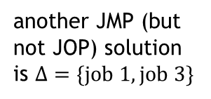




Problem Definition + Example
DEF: (Job Set Optimization Problem – JOP)
Given: JSSP instance $P$ with job set $J$, deadline $k∈ℕ$
utility function $u$: assigns a utility $u_{j}∈ℕ$ to each job $j∈J$
Find: $Δ⊆J$ such that
(1) $P$ with the reduced job set $J∖Δ$ has a solution schedule $σ$ with $time(σ)≤k$ (2) there is no other such $Δ‘⊆J$ that satisfies $\sum_{j∈J∖Δ′}{u_{j}} > \sum_{j∈J∖Δ}{u_{j}}$
DEF: (Job Set Maximization Problem – JMP)
Given: JSSP instance $P$ with job set $J$, deadline $k∈ℕ$
Find: $Δ⊆J$ such that
(1) $P$ with the reduced job set $J∖Δ$ has a solution schedule $σ$ with $time(σ)≤k$ (2) there is no other such $Δ‘⊆J$ that satisfies $Δ^{′}⊂Δ$
relax the
problem
machines:
$$m_{1}$$
$$m_{2}$$
$$m_{3}$$
solution $Δ=\{job 4\}$:
$$∀j∈J: u_{j}=1$$
Example
$Δ$ is also a JMP solution
deadline $k$
job 1
op1
op2
op3
op1
op2
op3
$$m_{1}$$
op1
op3
another JMP (but
not JOP) solution
is $Δ=\{job 1, job 3\}$
job 2
op1
op2
op3
op2
op3
op1
op2
$$m_{2}$$
op1
job 3
op1
op2
op3
op1
op2
op3
$$m_{3}$$
op2
op3
job 4
op1
op2
op3
0
6
time

Slide 61
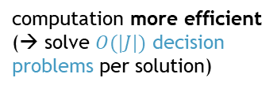
Approach
→ some JMP solutions are JOP solutions
Foundation: four observations
Obs1: each JOP solution is a JMP solution
Obs2: JMP has lower complexity than JOP
Obs3: for JMP, efficient algorithms do exist
Obs4: CP solvers typically do not support JMP solving
Idea:
draw a random sample in the JMP solution space
Procedure (Outline):
• solve multiple randomly modified JMP instances
• store solution with best utility throughout process, stop if required solution quality is achieved
intuitively: JOP = finding best JMP solution
e.g., QuickXplain [Junker, 2004],
Progression [Marques-Silva et al, 2013],
Inverse QuickXplain [Schekotihin et al, 2014]
cannot use CP solver to exploit JMP solving for JOP solving
computation more efficient
(→ solve $O(|J|)$ decision problems per solution)
Solutions_{JMP}
"direct" computation is hard
(→ solve one optimization
problem per solution)
in our tests: single-digit # of minutes per decision
CP Solver
Solutions_{JOP}
in our tests: multiple hours per optimization
"best" JMP solutions
e.g.: if every 10-th JMP solution is a JOP solution:
→ randomly sampling 20 JMP solutions yields
JOP solution with 88 % probability

Slide 62


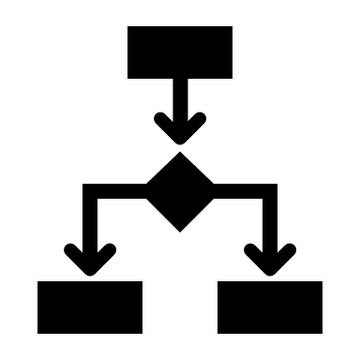
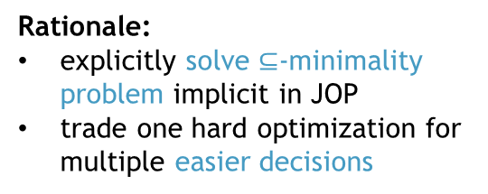





Approach
Rationale:
explicitly solve $⊆$-minimality
problem implicit in JOP
trade one hard optimization for
multiple easier decisions
Optimization by
randomization
Illustration:
Modules:
• CP solver (for solving decision versions of JSSP)
• JMP unit (for finding JMP solutions)
• random number generator (for generating multiple random solutions)
Properties:
no information exchange between different JMP computations
no manual adaptation of CP encoding of given JSSP needed
all modules viewed as black-boxes
JMP solving
RNG
CP Solver
JSSP Decision
Oracle
Solutions_{JMP}
random
JOP instance
$$⟨P,k,u⟩$$
$$⟨P,k⟩$$
JMP unit
Solutions_{JOP}
Problem
Instance
Modifier
$${\left\langle P,k\right\rangle }_{rnd}$$
Search
Algo-
rithm
…
random
$$u$$
random
best solution(s) wrt. $u$
JMP solutions
efficient parallelization
reduce human interaction
can use most suitable/performant algorithms for given problem

Slide 63
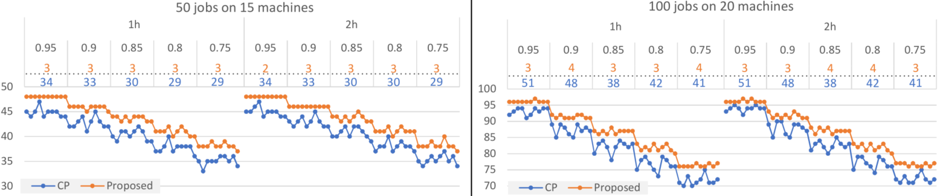

Evaluation
importantly: algorithm is generally applicable to any diagnosis problem (and expected to have a similarly positive impact whenever reasoning is highly expensive)
Dataset: 100 JOP instances (based on Taillard's JSSP benchmarks [Taillard, 1993])
50 instances (50 jobs, 15 machines) 50 instances (100 jobs, 20 machines)
5 degrees of over-constrainedness (deadlines: $k∈\left\{95,90,85,80,75\right\}\%$ of ${time}^{∗}$)
Experiments:
comparison: "direct" CP approach vs. proposed "indirect" approach
modules:
Results:
for both timeouts + all JOP instances: Proposed is better (higher # of scheduled jobs) than CP
Proposed yields always better results within 1h than CP in 2h
improvements: avg/max more scheduled jobs: 8% / 15% and 5% / 13%
2 computation timeouts (1h, 2h)
minimal time to schedule all jobs
CP solver: IBM's CP Optimizer
(state-of-the-art CP solver
for JSSP [Da Col, Teppan, 2019])
CP solver: IBM's CP Optimizer
JMP algo: Inverse QuickXplain
RNG: Java RNG

Slide 64
DynamicHS:
Streamlining Reiter's Hitting-Set Tree for Sequential Diagnosis
Module addressed
Goals
minimize
expensive
reasoning
optimize time performance for use in sequential diagnosis
while maintaining other desirable properties
Patrick Rodler, 2022
Information Sciences

Slide 65
















The Problem
(still) state-of-the-art in various diagnosis domains + scenarios!
Diagnosis computation (existing): Reiter‘s HS-Tree (Reiter,1987)
Example (cont‘d):
Key:
conflicts
paths that are diagnoses
paths that are no diagnoses
$C…$ computed
$R…$ reused
Pros:
sound + complete
(computes only + all diagnoses)
best-first
(most preferred diagnoses first, e.g., smallest or most probable)
generally applicable
(independent of system description language
+ used theorem prover)
Con:
no provisions for being used in sequential diagnosis scenario
1
$${〈X_{1},A_{2},O_{1}〉}^{C}$$
conflict computation is expensive
(theorem prover calls) !
$$X_{1}$$
$$O_{1}$$
$$A_{2}$$
2
Breadth-first!
(or: uniform-cost,
if weights given)
3
4
✔$(D_{1})$
$${〈X_{1},X_{2}〉}^{C}$$
$${〈X_{1},X_{2}〉}^{R}$$
$$X_{1}$$
$$X_{2}$$
$$X_{1}$$
$$X_{2}$$
5
6
7
8
✖$(⊃D_{1})$
✔$(D_{2})$
✖ $(⊃D_{1})$
✔$(D_{3})$
which one is the true diagnosis
(= actually faulty components) ?
make system measurements to isolate true diagnosis → sequential diagnosis
diagnosis problem changes after each measurement
Notes:
$$≥$$

Slide 66
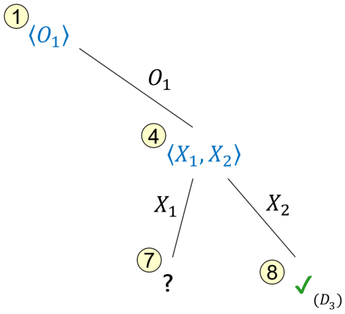
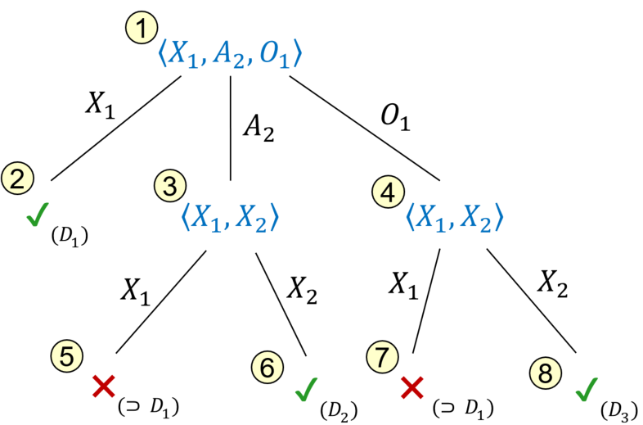






New Approach: DynamicHS
“When new diagnoses do arise as a result of system measurements, can we determine these new diagnoses in a reasonable way from the (...) HS-Tree already computed in determining the old diagnoses?“ (Raymond Reiter, 1987)
yes!
~4500 citations (Google Scholar)
Sequential Diagnosis = conduct system measurements to find true diagnosis among diagnoses
using HS-Tree
using DynamicHS
build new tree from scratch
(redundant expensive operations!)
return best
diagnosis
expand adapted tree (minimize redundancy!)
if diagnostic goal reached
Diagnosis System
preferred
diagnoses
Measurement
Point
Selection
DPI $Prob_{i}$
2
1
Diagnosis
Computation
DPI = diagnosis
problem instance
= $Prob_{i}$ + new meas
new DPI $Prob_{i+1}$
best measure ment point
“discard+rebuild“
?
“reuse+adapt“
3
Measurement
Conduction
prune + relabel
4
Knowledge
Update
new
measure-
ment
User / Oracle
what happens with
the search tree ?
?
1
$$out\left(A_{2}\right)=1$$

Slide 67
Results
measurement point selection functions
Observations:
In all scenarios, DynamicHS leads to significant avg. runtime savings (avg 52% / max 70%)
DynamicHS shows better runtime in >98% of all single sessions
Notably:
DynamicHS retains all desirable properties (sound, complete, best-first, generally applicable)
real-world DPIs
20 runs, each with different randomly chosen solution to be located
# of preferred diagnoses computed per sequential diagnosis iteration
Notes:
DynamicHS outperforms HS-Tree on avg. in all cases, and often significantly

Slide 68
StaticHS: A Variant of Reiter's Hitting Set Tree for Efficient Sequential Diagnosis
Module addressed
Goals
minimize interaction
(# of queries)
Patrick Rodler, Manuel Herold, 2018
Int'l Symposium on Combinatorial Search (SoCS)

Slide 69









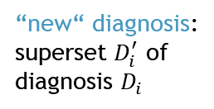




Sequential Diagnosis
different possible algorithms
(e.g. Reiter's HS-Tree)
hard computational task, can usually
only compute some diagnoses
Process:
Evolution of the space of diagnoses:
input
output
DPI
compute diagnoses $D$
actually faulty components
$$\left|D\right|=1$$
iteration 0: $dpi_{0}$
iteration 1: $dpi_{1}$
iteration 2: $dpi_{2}$
…
$$D$$
update knowledge
compute measure-ment point $p_{i}$
maybe: optimize based
on some heuristic, e.g.
information gain
expensive!!
$〈SD,COMPS,MEAS〉$ becomes
$〈SD,COMPS,MEAS∪\left\{m_{i}\right\}〉$
$$m_{i}$$
ask oracle
$$p_{i}$$
oracle = engineer (physical system),
domain expert (KB), etc.
measure-
ment $m_{1}$
diagnoses for $dpi_{2}$
diagnosis $D_{i}$
invalidates
diagnoses for $dpi_{0}$
…
“new“ diagnosis:
superset $D_{i}^{′}$ of
diagnosis $D_{i}$
diagnoses for $dpi_{1}$

Slide 70

Sequential Diagnosis
different possible algorithms
(e.g. Reiter‘s HS-Tree)
hard computational task, can usually
only compute some diagnoses
Process:
The solved problem is:
DynSD-Problem:
Given: DPI $〈SD,COMPS,MEAS〉$.
Find: Set of measurements $M$ such that there is only one diagnosis for $〈SD,COMPS,MEAS∪M〉$.
Optimization Version:
OptDynSD-Problem:
Given: DPI $〈SD,COMPS,MEAS〉$.
Find: Minimal-cost set of measurements $M$ to solve DynSD problem.
input
output
DPI
compute diagnoses $D$
actually faulty components
$$\left|D\right|=1$$
iteration 0: $dpi_{0}$
iteration 1: $dpi_{1}$
iteration 2: $dpi_{2}$
…
$$D$$
update knowledge
compute measure-ment point $p_{i}$
maybe: optimize based
on some heuristic, e.g.
information gain
expensive!!
$〈SD,COMPS,MEAS〉$ becomes
$〈SD,COMPS,MEAS∪\left\{m_{i}\right\}〉$
$$m_{i}$$
ask oracle
$$p_{i}$$
oracle = engineer (physical system),
domain expert (KB), etc.

Slide 71
Sequential Diagnosis
different possible algorithms
(e.g. Reiter‘s HS-Tree)
hard computational task, can usually
only compute some diagnoses
Process:
Ways to tackle Optimization Problem (OptDynSD):
(existing) selecting “good“ measurement points
(e.g. with high information gain, high expected diagnosis elimination rate)
(we suggest) changing the way of diagnoses computation
(diagnosis search space restriction)
→ both approaches can be readily and well combined with one another
input
output
DPI
compute diagnoses $D$
actually faulty components
$$\left|D\right|=1$$
iteration 0: $dpi_{0}$
iteration 1: $dpi_{1}$
iteration 2: $dpi_{2}$
…
$$D$$
update knowledge
compute measure-ment point $p_{i}$
maybe: optimize based
on some heuristic, e.g.
information gain
expensive!!
$〈SD,COMPS,MEAS〉$ becomes
$〈SD,COMPS,MEAS∪\left\{m_{i}\right\}〉$
$$m_{i}$$
ask oracle
$$p_{i}$$
oracle = engineer (physical system),
domain expert (KB), etc.

Slide 72




Sequential Diagnosis
different possible algorithms
(e.g. Reiter‘s HS-Tree)
hard computational task, can usually
only compute some diagnoses
Process:
Idea:
do not update DPI in each iteration
instead: use new measurements only as constraints on the diagnosis search space
intuitively: “freeze“ diagnosis search space, no “new“ diagnoses
That is, solve another problem:
(Opt)StatSD-Problem:
Given: DPI $〈SD,COMPS,MEAS〉$.
Find: (Minimal-cost) set of measurements $M$ such that there is only one diagnosis for $〈SD,COMPS,MEAS〉$ + constraints $M$.
fixed!
input
keep state! no redundant
computations
output
still valid??
DPI
compute diagnoses $D$
actually faulty components
StatSD-Problem
general enough??
$$\left|D\right|=1$$
iteration 0: $dpi_{0}$
iteration 1: $dpi_{0}$
iteration 2: $dpi_{0}$
…
iteration 0: $dpi_{0}$
iteration 1: $dpi_{1}$
iteration 2: $dpi_{2}$
…
$$D$$
update knowledge
compute measure-ment point $p_{i}$
maybe: optimize based
on some heuristic, e.g.
information gain
expensive!!
$〈SD,COMPS,MEAS〉$ becomes
$〈SD,COMPS,MEAS∪\left\{m_{i}\right\}〉$
$$m_{i}$$
$$p_{i}$$
$〈SD,COMPS,MEAS〉$ becomes
$〈SD,COMPS,MEAS〉+$ constraint $\{m_{i}\}$
ask oracle
oracle = engineer (physical system),
domain expert (KB), etc.
cf. DynSD-Problem: … only one diagnosis for $〈SD,COMPS,MEAS∪M〉$.

Slide 73





StatSD vs. DynSD
diagnoses for $dpi_{1}$
Evolution of the space of diagnoses:
diagnoses for $dpi_{2}$
diagnoses for $dpi_{0}$
…
DynSD
NOK if actual diagnosis is, e.g., here
diagnoses for $dpi_{0}$+$\{m_{1}\}$
diagnoses for $dpi_{0}$+$\{m_{1},m_{2}\}$
diagnoses for $dpi_{0}$
…
search space restriction?
OK if actual diagnosis is in
completeness?
StatSD

Slide 74





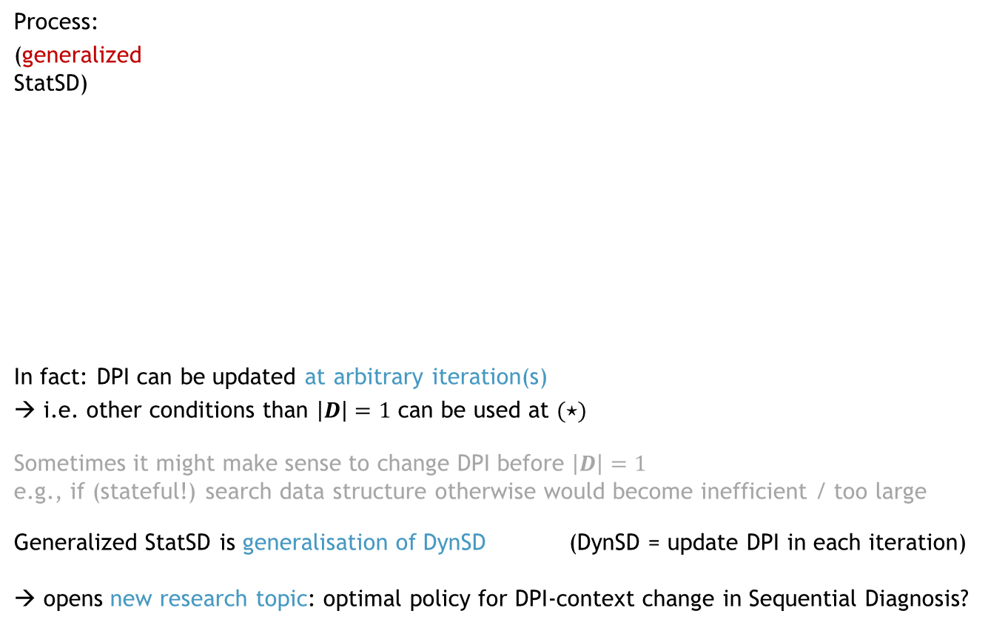





Search Space Restriction + Completeness
$〈SD,COMPS,MEAS〉$ becomes
$〈SD,COMPS,MEAS∪\{m_{1},…,m_{k}\}〉$
update DPI
Process:
(generalized
StatSD)
In fact: DPI can be updated at arbitrary iteration(s)
→ i.e. other conditions than $\left|D\right|=1$ can be used at $(⋆)$
Sometimes it might make sense to change DPI before $\left|D\right|=1$
e.g., if (stateful!) search data structure otherwise would become inefficient / too large
Generalized StatSD is generalisation of DynSD (DynSD = update DPI in each iteration)
→ opens new research topic: optimal policy for DPI-context change in Sequential Diagnosis?
updated DPI
$$\left(⋆\right) \left|D\right|=1 ∧ updated=F$$
DPI
compute diagnoses $D$
$$\left|D\right|=1$$
$$∧ updated=T$$
actually faulty components
$$updated=T$$
✔
$$D$$
update knowledge
compute measure-ment point $p_{i}$
$$updated=F$$
$$m_{i}$$
ask oracle
$$p_{i}$$
completeness?

Slide 75
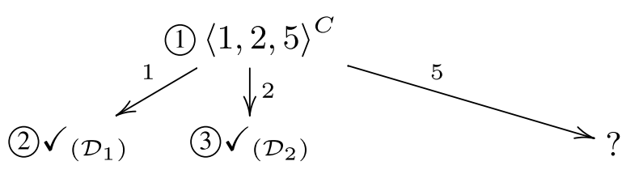
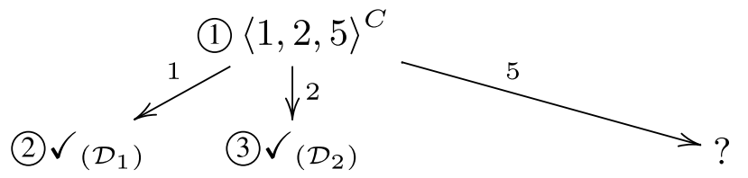
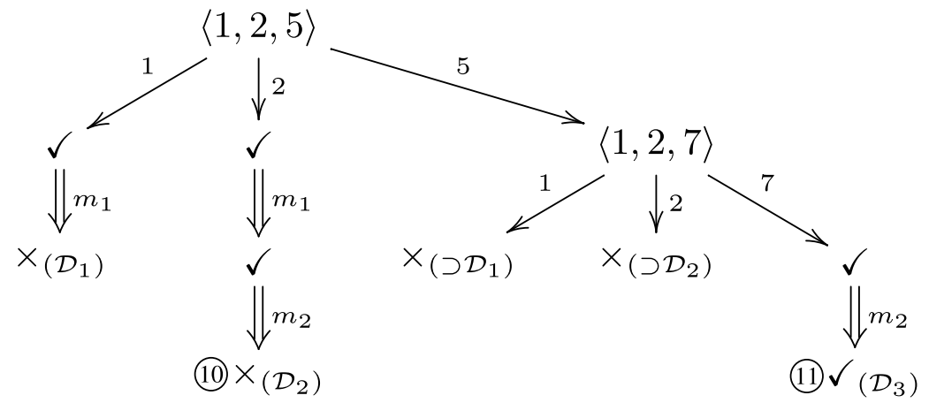
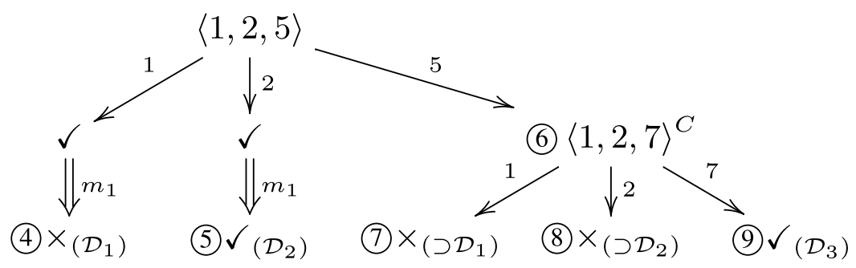
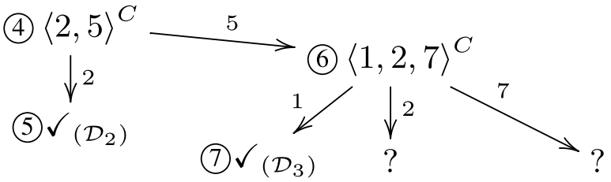
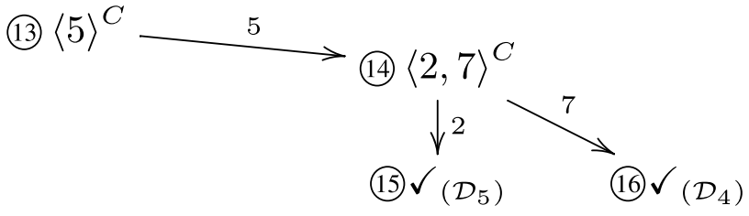
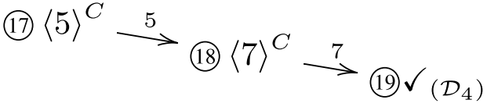
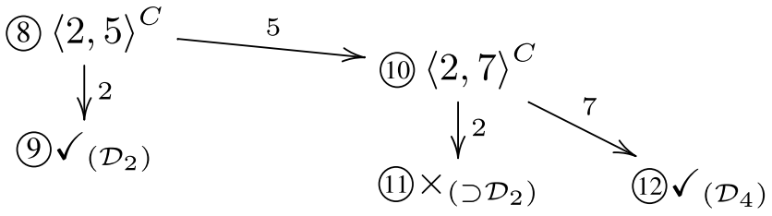






StaticHS: Stateful Diagnoses Search for StatSD
We propose StaticHS, an adaptation of Reiter‘s Hitting Set Tree (HS-Tree), that is
stateful (keeps state between iterations)
a procedure to solve (generalized) StatSD
as generally applicable (wrt.: systems, modeling languages, inference engines) as HS-Tree
Example (Solving StatSD vs. DynSD):
Given DPI $dpi_{0}$: $COMPS=\{1,…,7\}$, conflicts $〈1,2,5〉, 〈1,2,7〉$, actual diagnosis $\left[5,7\right]$
take measurement whenever 2 diagnoses are computed
StaticHS
Algo for DynSD (HS-Tree, build+discard)
4 measurements!
2 measurements!
actual diagnosis found
measurement $m_{4}$ → $MEAS∪\{m_{1},m_{2},m_{3},m_{4}\}$
measurement $m_{1}$ → $MEAS∪\{m_{1}\}$
measurement $m_{1}$ → $dpi_{0}+\{m_{1}\}$
measurement $m_{3}$ → $MEAS∪\{m_{1},m_{2},m_{3}\}$
measurement $m_{2}$ → $dpi_{0}+\{m_{1},m_{2}\}$
measurement $m_{2}$ → $MEAS∪\{m_{1},m_{2}\}$
actual diagnosis found

Slide 76


Evaluation (StatSD vs. DynSD)
actual diagnosis = random diagnosis (any DPI)
actual diagnosis = random diagnosis for $dpi_{0}$
143
49
1300
1781
143
49
1300
1781
48
90
1782
864
48
90
1782
864
DPI
$$|COMPS|$$
$\#$ of diagnoses for DPI ($dpi_{0}$)

Slide 77
Conclusions
Contributions:
New definition of Sequential Diagnosis Problem → (generalized) StatSD
→ more general than the usual problem definition
New hitting set search algorithm (StaticHS) to solve (generalized) StatSD
→ diagnosis search space reduction + preservation of completeness
Evaluation results:
Solving generalized StatSD compared to usual SD problem
→ saves
  on avg.: 20%
  max: 65%
of the sequential diagnosis effort (# of measurements)
leads to less/equal/more effort in 76%/21%/3% of the cases
Open Issue:
Research on when to optimally switch DPI-context in sequential diagnosis

Slide 78
Random vs Best-First: Impact of Sampling Strategies on
Decision Making in Model-Based Diagnosis
Module addressed
Goals
minimize time
(waiting time +
# of queries)
Patrick Rodler, 2022
AAAI Conference on Artificial Intelligence (AAAI)

Slide 79
Motivation
Assume an election poll:
  Ask only university professors for whom they will vote
  Will the result of the poll be representative of the entire population?
Similar thing is often done in MBD
  Task: find actual diagnosis among a (large) set of diagnoses
  Computing all diagnoses intractable → compute only a sample of diagnoses
  Use sample to make estimations that guide diagnostic actions (meaurements)
  Draw best-first samples (e.g. most probable diagnoses)
But:
Statistical Law:
    "A randomly chosen unbiased sample from a population allows (on average) better
    conclusions and estimations about the whole population than any other sample."
Questions of Interest:
  Does this apply to MBD as well?
  Or are best-first samples really more informative than random ones in MBD?
  Perhaps we could do better by using randomized algorithms to generate diagnoses?
Contribution:
  Extensive experiments to bring light to these questions

Slide 80

Example (Impact of Sample in MBD)
recall: common MP selection heuristics use exactly these two properties!
Diagnosis problem:
  4 diagnoses: $D_{1},…,D_{4}$
  probabilities: $⟨ p\left(D_{1}\right),…,p\left(D_{4}\right) ⟩ =⟨ .37, .175, .175, .28 ⟩$
Consider MPs $m_{1}$, $m_{2}$ → two possible outcomes (T/F) each
Given sample of diagnoses → assess quality of each MP based on its properties wrt.
  probability $p$ of T/F outcomes
  diagnosis elimination rate $e$ for T/F outcomes
Consider 3 samples $S1=\{D_{1},D_{2},D_{3},D_{4}\}, S2=\{D_{1},D_{2},D_{3}\}, S3 = \{D_{2},D_{3},D_{4}\}$
Different samples can yield significantly different estimations
  $p_{S1}\left(m_{1}=T\right)=.55$ $p_{S1}\left(m_{1}=F\right)=.45$
  $p_{S2}(m_{1}=T)=.76$ $p_{S2}(m_{1}=F)=.24$
  $e_{S1}(m_{1}=T)= .5$ $e_{S1}(m_{1}=F)=.5$
  $e_{S2}(m_{1}=T)= .33$ $e_{S2}(m_{1}=F)=.67$
all diagnoses
(unknown)
sample S3
sample S2
sample S1

Slide 81



Example (Impact of Sample in MBD)
which MP is better wrt. information gain?
information gain: higher if probabilities of meaurement outcomes are closer to 0.5
Diagnosis problem:
  4 diagnoses: $D_{1},…,D_{4}$
  probabilities: $⟨ p\left(D_{1}\right),…,p\left(D_{4}\right) ⟩ =⟨ .37, .175, .175, .28 ⟩$
Consider MPs $m_{1}$, $m_{2}$ → two possible outcomes (T/F) each
Given sample of diagnoses → assess quality of each MP based on its properties wrt.
  probability $p$ of T/F outcomes
  diagnosis elimination rate $e$ for T/F outcomes
Consider 3 samples $S1=\{D_{1},D_{2},D_{3},D_{4}\}, S2=\{D_{1},D_{2},D_{3}\}, S3 = \{D_{2},D_{3},D_{4}\}$
Different samples can lead to different diagnostic decisions
  $p_{S1}(m_{1}=T)=.55$ $p_{S1}(m_{1}=F)=.45$
  $p_{S1}(m_{2}=T)=.72$ $p_{S1}(m_{2}=F)=.28$
  $p_{S3}(m_{1}=T)=.28$ $p_{S3}(m_{1}=F)=.72$
  $p_{S3}(m_{2}=T)=.55$ $p_{S3}(m_{2}=F)=.45$
→ similar observations for other MP selection heuristics!
all diagnoses
(unknown)
sample S3
sample S2
$m_{1}$ better
$m_{2}$ better
sample S1

Slide 82
Evaluation Approach (Details)
Sample Types:
  best-first (bf) → most probable diagnoses
  random (rd) → unbiased random selection from diagnoses
  worst-first (wf) → least probable diagnoses
  approx best-first (abf)
  approx random (ard)
  approx worst-first (awf)
bf, rd, wf are specific samples → sampling outcome is precisely predefined
→ usually more expensive (exact techniques)
abf, ard, awf are unspecific samples → exact sampling outcome not known
→ usually less expensive (approximate techniques)
Computation of Samples:
bf uniform-cost HS-Tree
rd determine all diagnoses, sample randomly
wf determine all diagnoses, select least probable diagnoses
abf Inv-HS-Tree with sorting of COMPS by probability in descending order
ard Inv-HS-Tree with random sorting of COMPS
awf Inv-HS-Tree with sorting of COMPS by probability in ascending order
"baselines"
heuristic approximations
HS-Tree [Reiter, 1987]
Uniform-Cost HS-Tree [Rodler, 2015]
Inv-HS-Tree [Schekotihin et al, 2014]

Slide 83

Evaluation Approach (Details)
Evaluation Criteria for Sample Types:
Theoretical Representativeness: sample type is the more representative, the better the
  probability estimates for MPs $m$ match real probabilities for $m$
  elimination rate estimates for MPs $m$ match real elimination rate for $m$
Practical Representativeness: sample type is the more representative, the lower the
  # of measurements
  time
  required until the isolation of the actual diagnosis
Research Questions:
RQ1: Which type of sample is best in terms of theoretical representativeness?
RQ2: Which type of sample is best in terms of practical representativeness?
RQ3: Does larger sample size (more computed diagnoses) imply better representativeness?
RQ4: Does a better theoretical representativeness translate to a better practical representativeness?
accuracy
efficiency

Slide 84
Conclusions
Goal:
Assess impact of different sample types on diagnostic decision making and efficiency
Special Focus on:
Statistical unfoundedness of best-first samples (commonly used in MBD)
Theoretical attractiveness of random samples (not commonly used in MBD)
Extensive Experiments:
8 real-world problem cases, 6 sample types,
5 sample sizes, 4 MP selection heuristics
Bottom Line:
Random samples → very good estimations
→ but only (most) efficient for large samples + one particular heuristic
Best-first samples → best for small sample size + most common heuristics
→ but can be drastically worse than other sample types in certain scenarios
"Unspecific" approximate samples → best for medium sample size + two heuristics
Larger samples → better estimations, but no higher diagnostic efficiency (in general)
Better estimates → no higher diagnostic efficiency (in general)
Time-information trade-off in diagnostic sampling
→ recommendations which sample type to use in which diagnostic scenario
12.000 analyzed MPs,
~10.000 solved diagnosis problems
up to > double the effort for user
more efficient sampling → less effective measurements
reason: heuristic (non-opt) meas-urement selection

